Slide 1


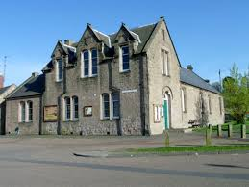
Digital connection is a human right
What role can village halls play?

Slide 2
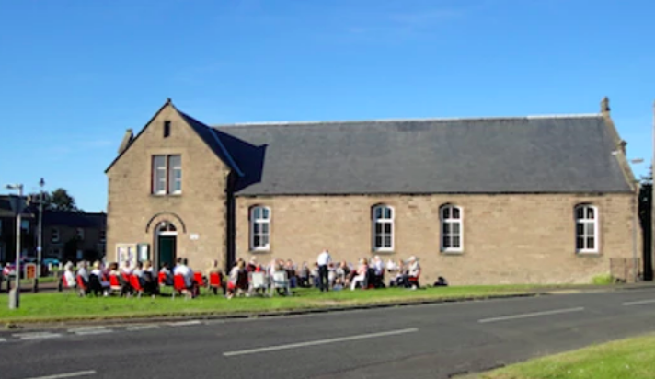
The Survey
99 Village Halls in Northumberland took part in online survey
54% did have internet connection, 46% were not connected.
Why not connected?
  Cost
  Perceived lack of demand pre-COVID-19

Slide 3
The Survey
What’s changed post-COVID-19?
83% would like to be connected
‘Life enhancer’ for village residents
Broaden scope of activities provided by the halls
50% of all the halls surveyed interested in becoming a digital hub
“The pandemic has demonstrated how important digital connection is in small relatively remote communities like ours - we are aware now about the potential through internet connection to enhance existing use and develop use as a community internet hub.’

Slide 4
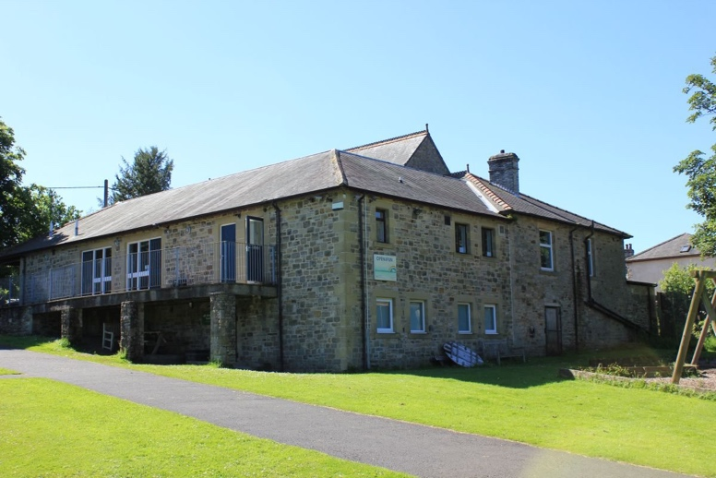
Benefits of being connected
Enhancing existing activities
Accessing on-line services
Learning/ training
Social Inclusion
Service provision

Slide 5
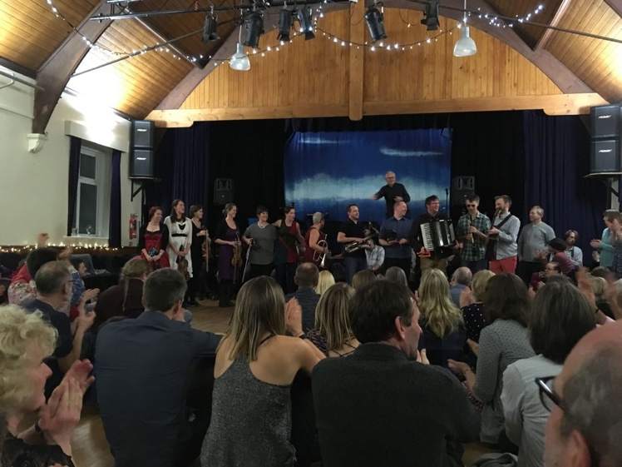
Recommendations
Providers offer charity rates
More funding be made available for devices
Support for digital champions
More training be made available in halls
A “help desk” for halls
Recognition of the role halls play in tackling hidden rural poverty

