Slide 1
Involving Young People
Marc Johnson
VCS Support Services Manager
Northumberland CVA
Tracey Morgan
Community Development Officer
Community Action Northumberland

Slide 2
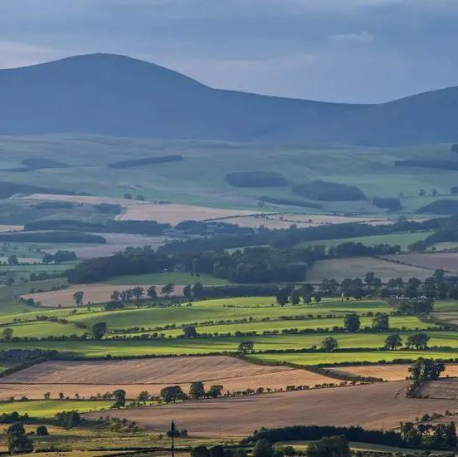
Intro
What's it like growing up in rural Northumberland?
Positives
Negatives

Slide 3
Ballinger – Lottery Funding
The Ballinger Charitable Trust were awarded £400,000 from National Lottery Community Fund for direct delivery of youth activities.
Larger awards were given to more established youth groups.
Micro-commissioning for smaller groups / non-youth-groups. Up to £1000
CAN and Northumberland CVA worked in partnership
2 online events to award funds

Slide 4
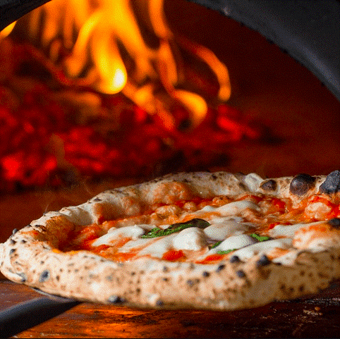
Breamish Hall, Powburn
A day Trip to Northumberland Country Zoo. Also, a day creating pizzas and crafts with the children and volunteers. Cooking lunch for everyone.
Trip costs including travel and lunch. Pizza oven.

Slide 5
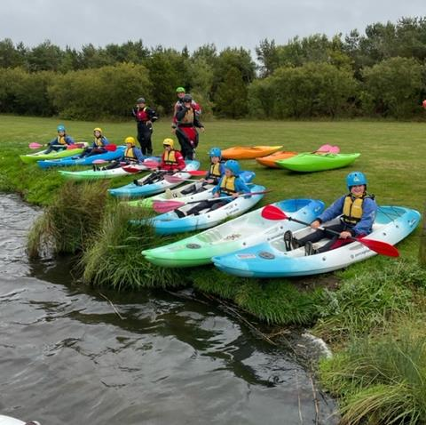
Felton Village Hall
Parents of 7–11 year-olds volunteered to organise a 6-month pilot programme of activities including ; paddleboarding, kayaking Music session, drama session, cooking , craft and a party.

Slide 6
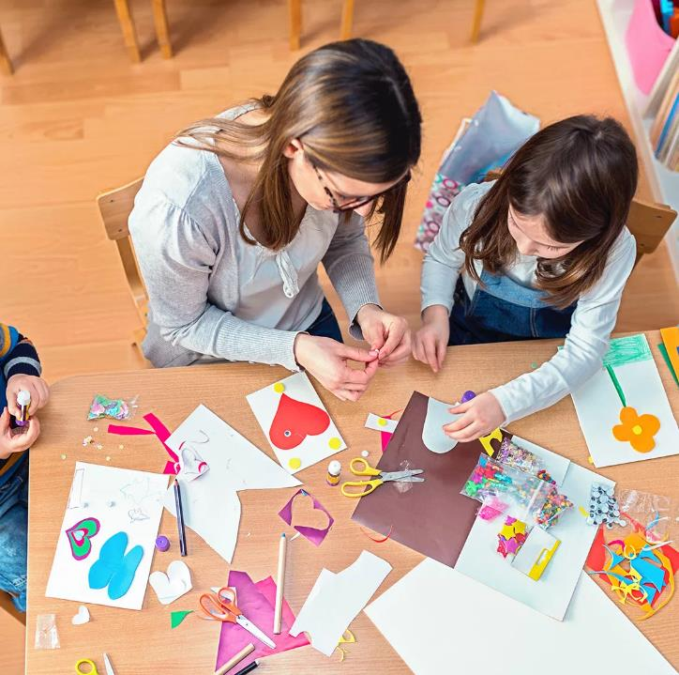
Longhoughton Community Hall
One or two sessions per week in the summer holidays. With the centre open for a few hours, provide arts, crafts and a space to meet or play sport with the 3G pitch available, with food available for free.

Slide 7
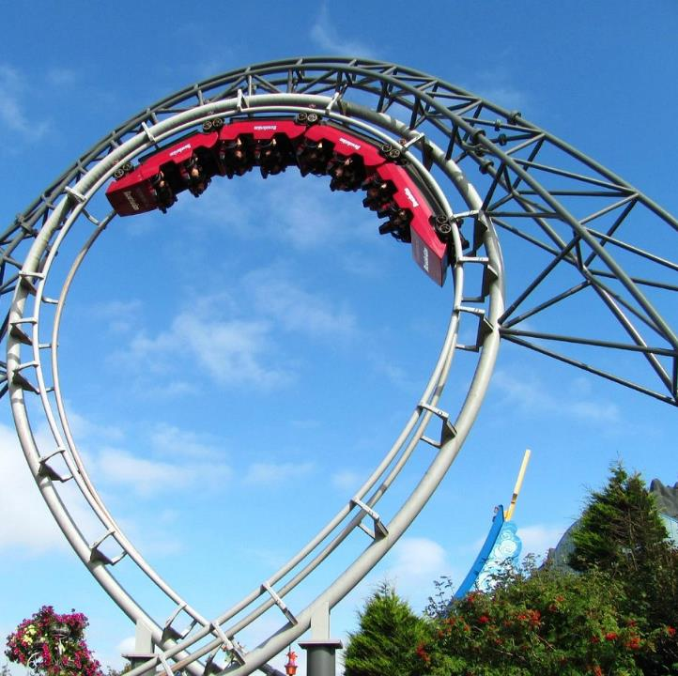
Reed Hall, Bellingham
1 trip for the junior youth group and 1 trip for the senior youth club. Snacks are also included.

Slide 8
Falstone Village Hall
Cinema and theme nights, Harry Potter, Spook night, Christmas evening.
Projector, Screen, DVD player, Treats & Film License

Slide 9
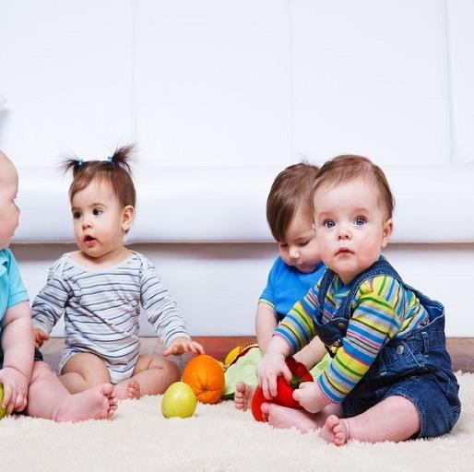
Ellingham Village Hall
Need local events for c & yp and a toddler group to stop the need for timely and costly travel. Consultation fun day to engage the community.
Free/reduced rent to allow groups to develop. Equipment for children. Entertainer for event. Food and refreshments for event .

Slide 10
Crookham Village Hall
Building on summer stay and play sessions boogie beat sessions, themed seasonal events , children’s film club.
Boogie beat, films, cups and dishes, sensory toys, floor mats, materials for themed events.

Slide 11
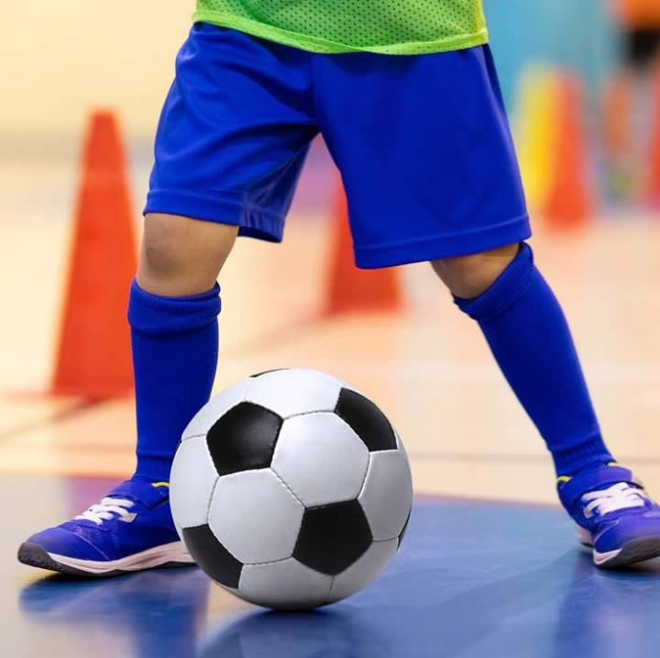
Holy Island Village Hall
C & YP have been consulted on what social activities they would like. Cinema nights, winter party, craft day, sports activity, football.
Equipment funded to carry out activities

Slide 12
Are you inspired to do something in your community?
Talk to Northumberland CVA & CAN
1
Talk to young people in your community
2
Talk to parents, carers and guardians
3
Talk to other organisations e.g. Schools
4

