Slide 1
Village Halls refurbishments Thanks to Lottery funding

Slide 2
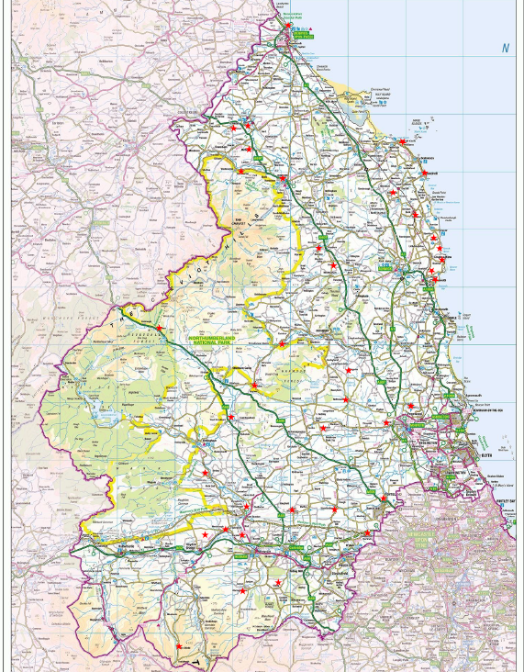
Map of Village Halls supported

Slide 3
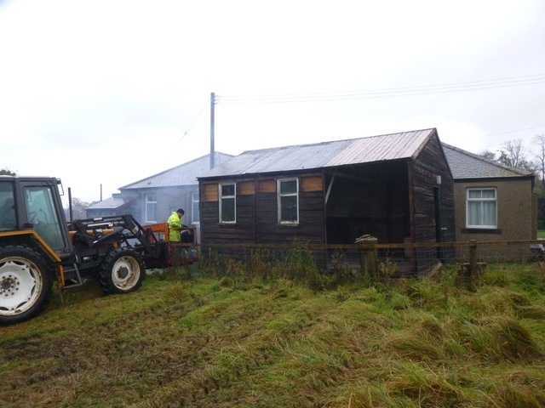
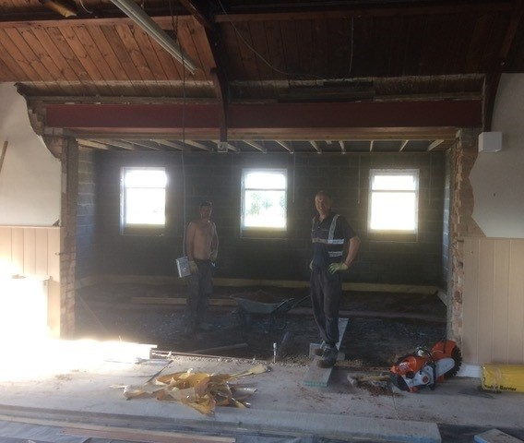
Middleton & Todridge Village hall
Extension to the main hall and accessible toilet fitted
The old shed with the hall in the background about to be demolished for reuse on a rewilding scheme on the edge of Middleton.

Slide 4
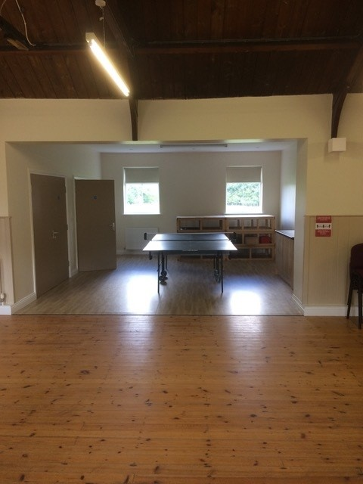
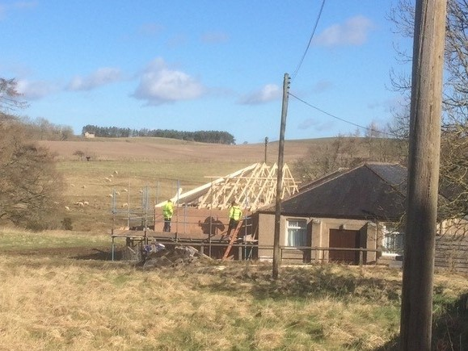
Middleton & Todridge Village hall
Extension to the main hall and accessible toilet fitted
“Our footfall figures indicate that in the last year more people have used the hall than we have ever recorded during the last 12 years.
We think this is a strong endorsement of the building improvements we have made"

Slide 5
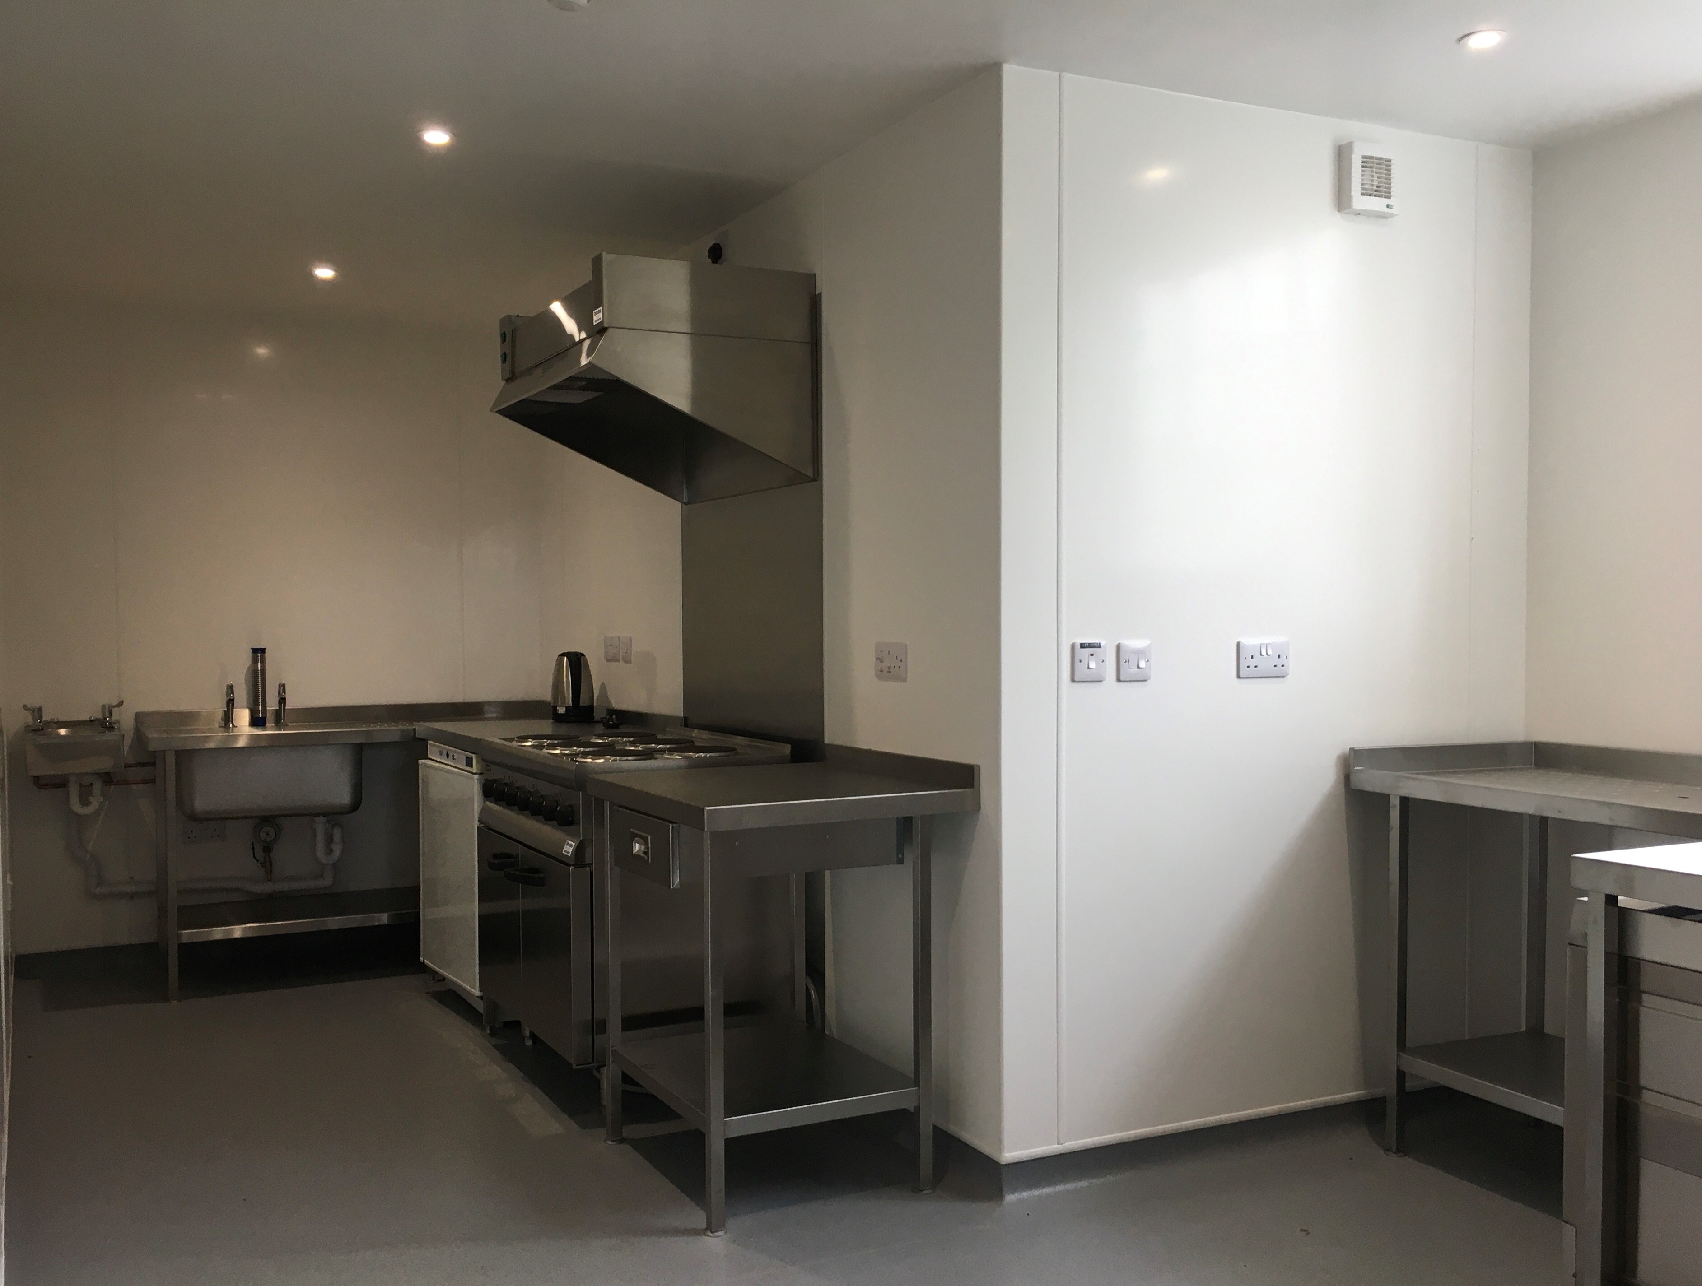
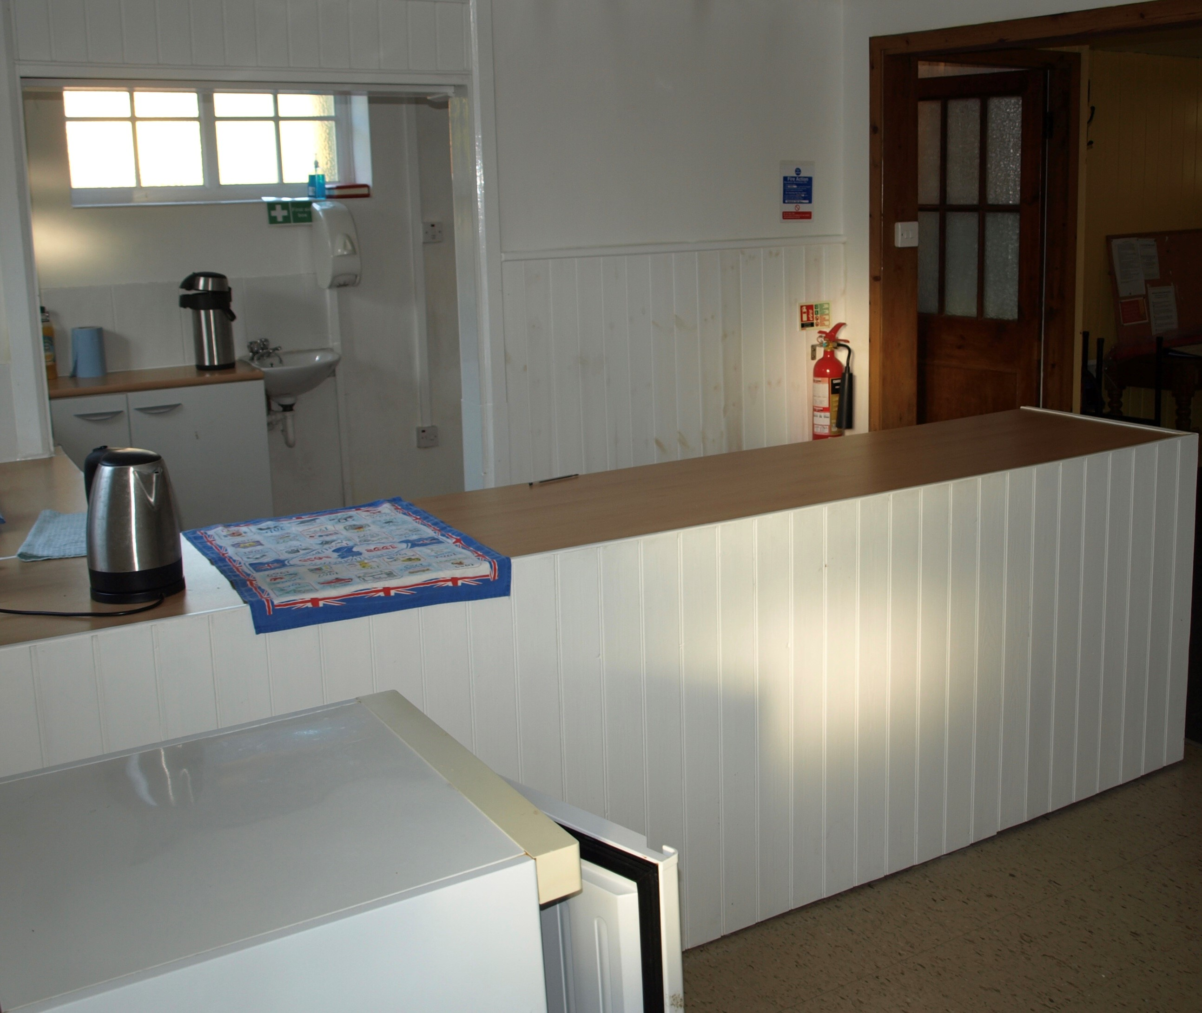
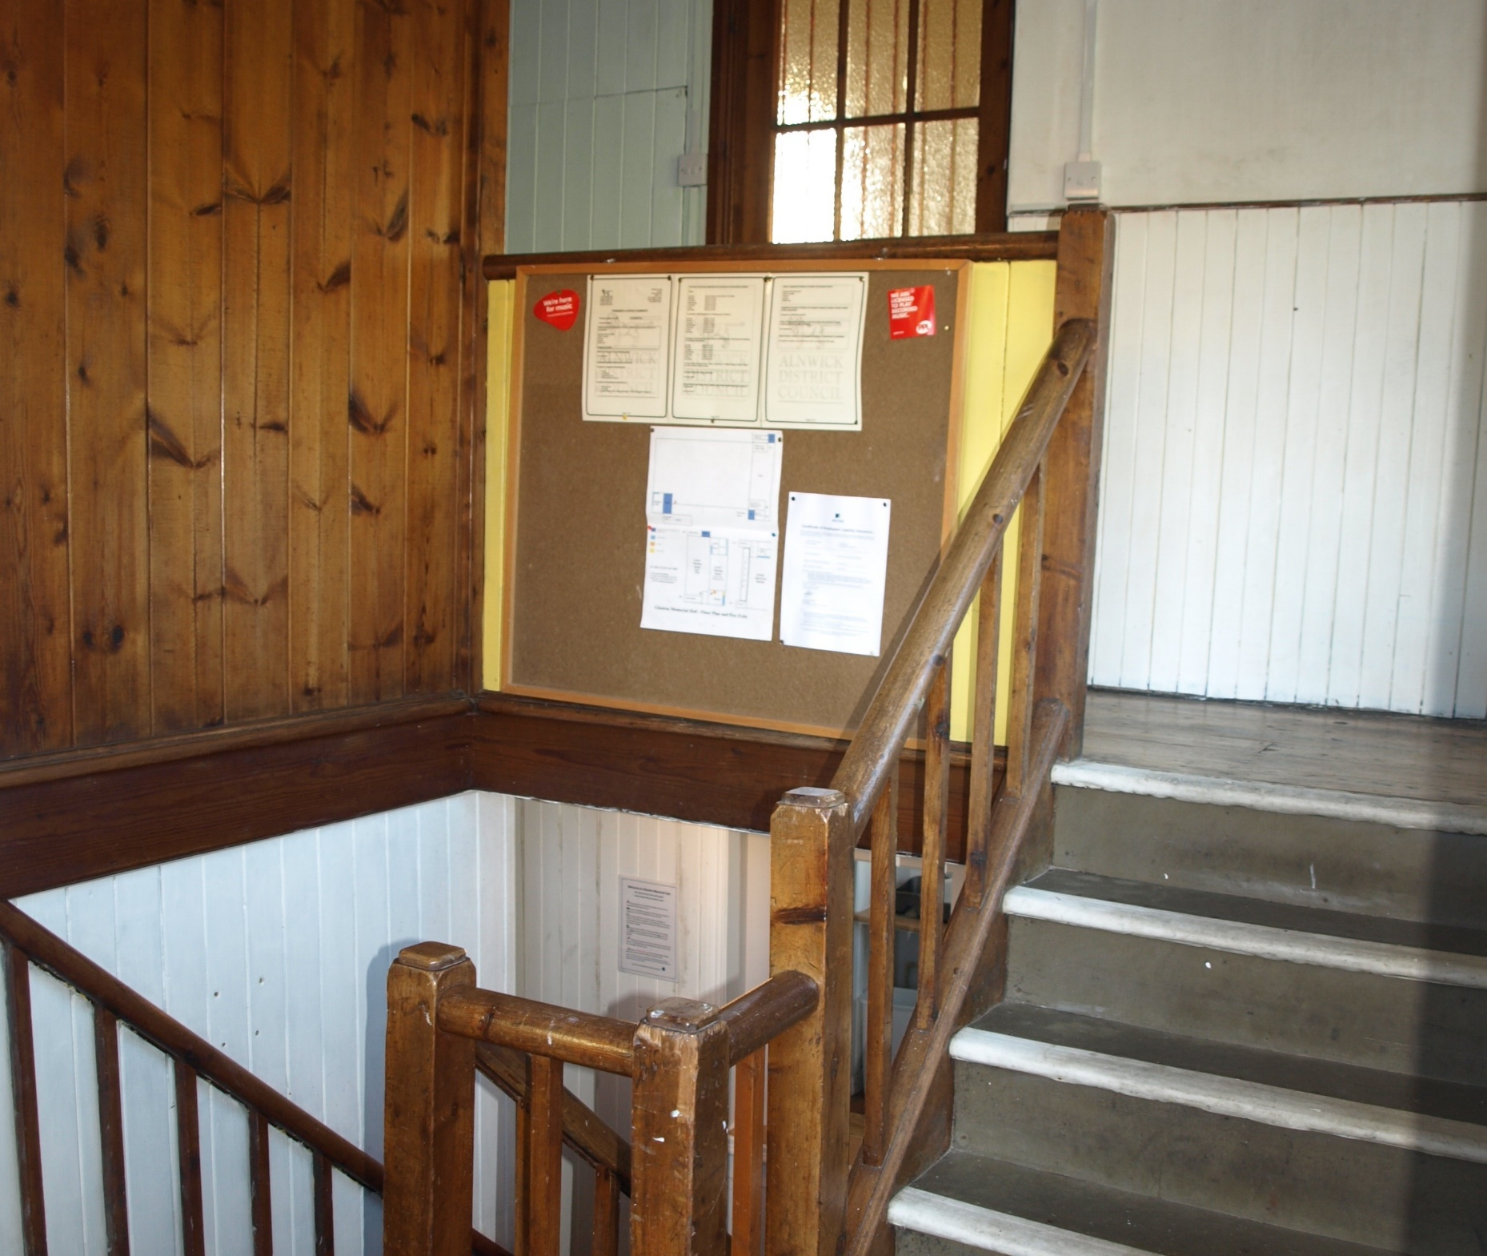
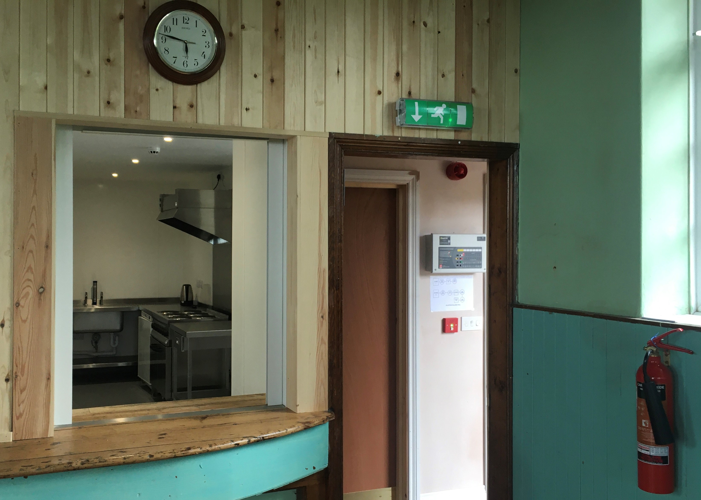
Glanton Village Hall
Re-siting of old, dated downstairs kitchen, to upstairs in the hall with modern steel units

Slide 6
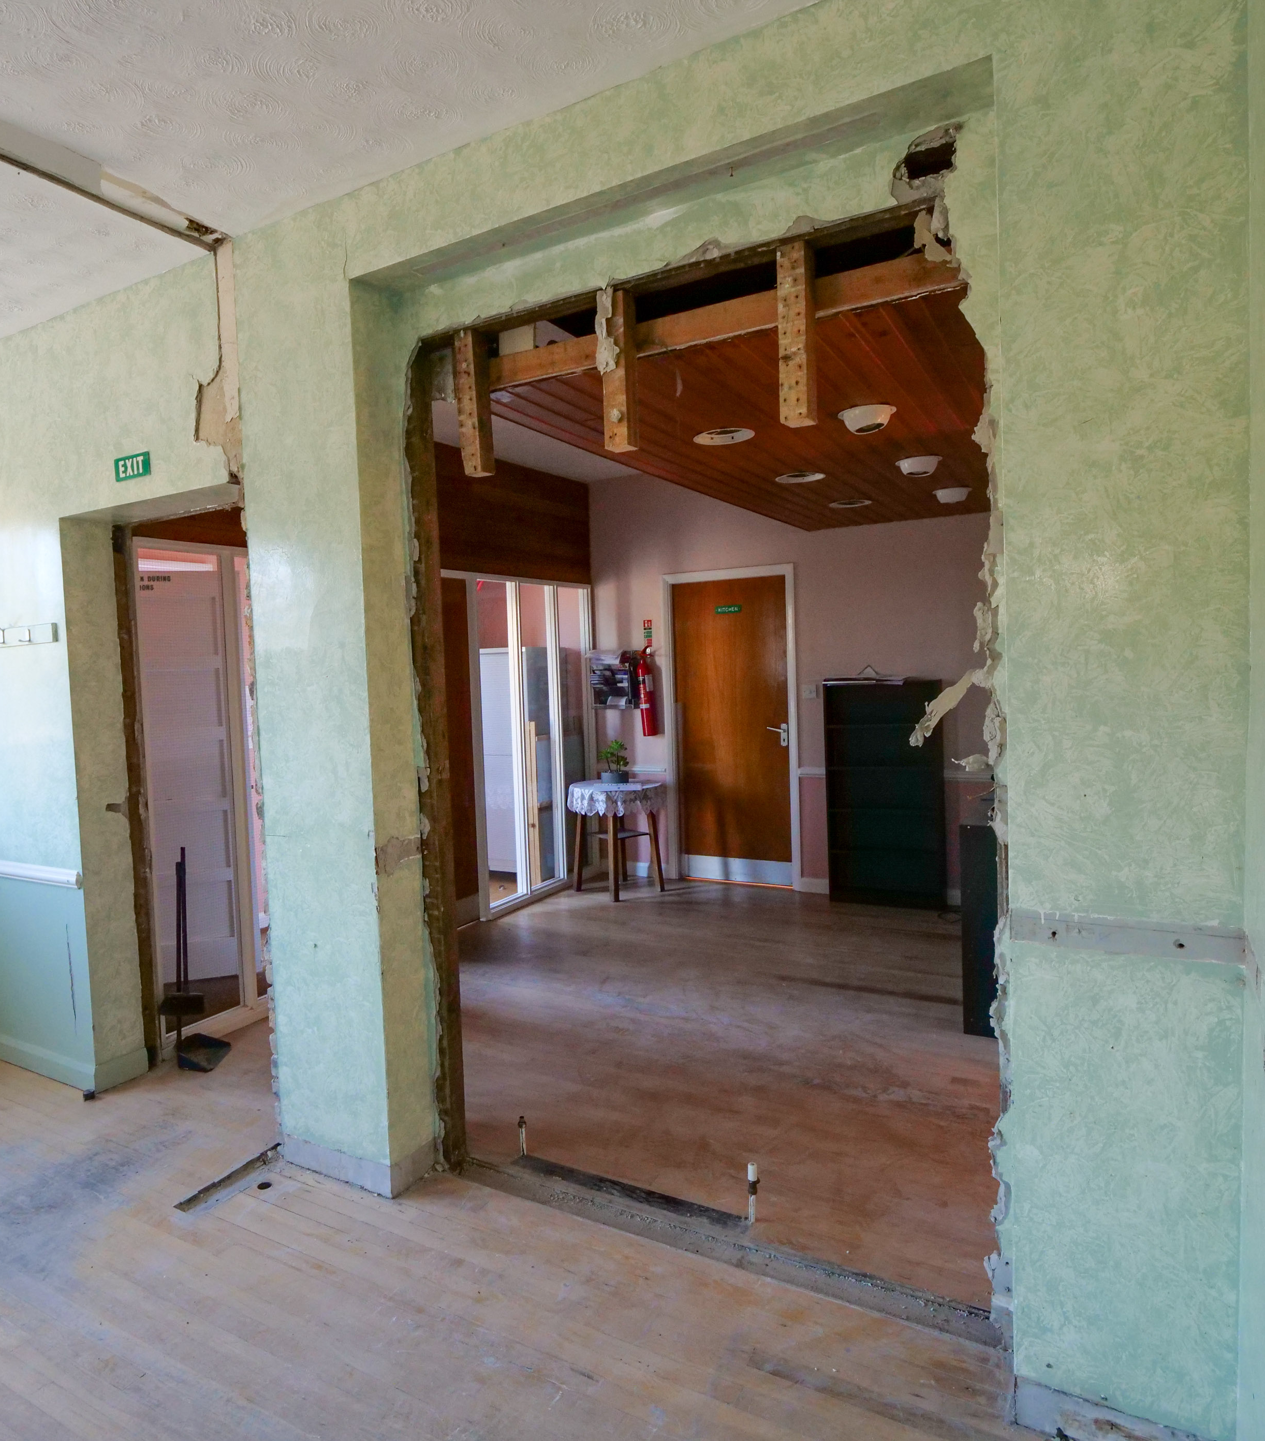
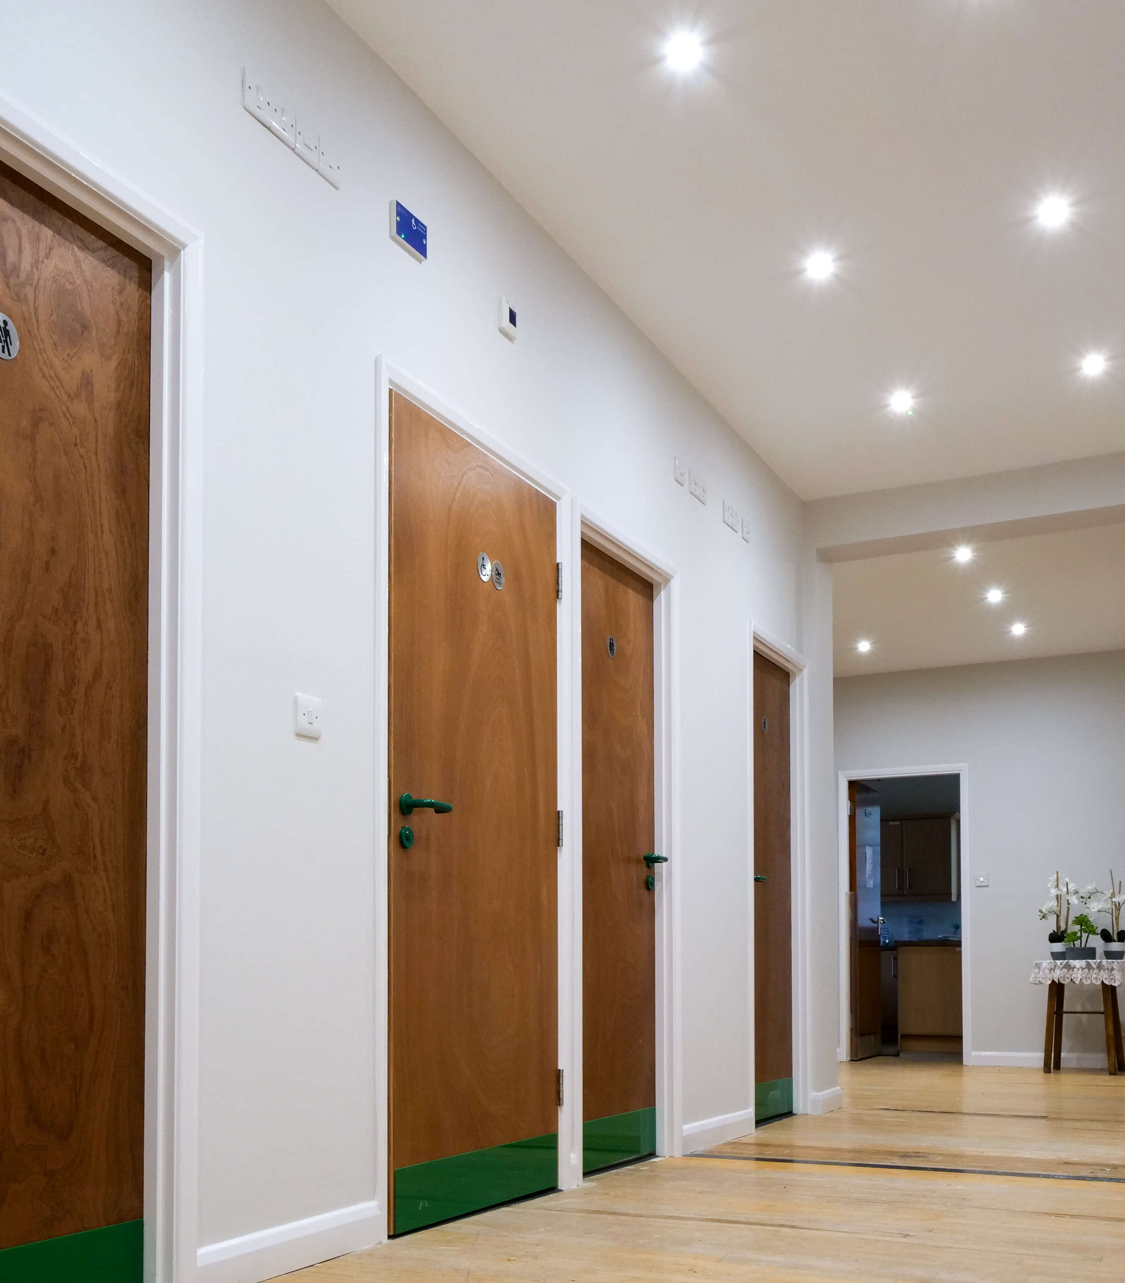
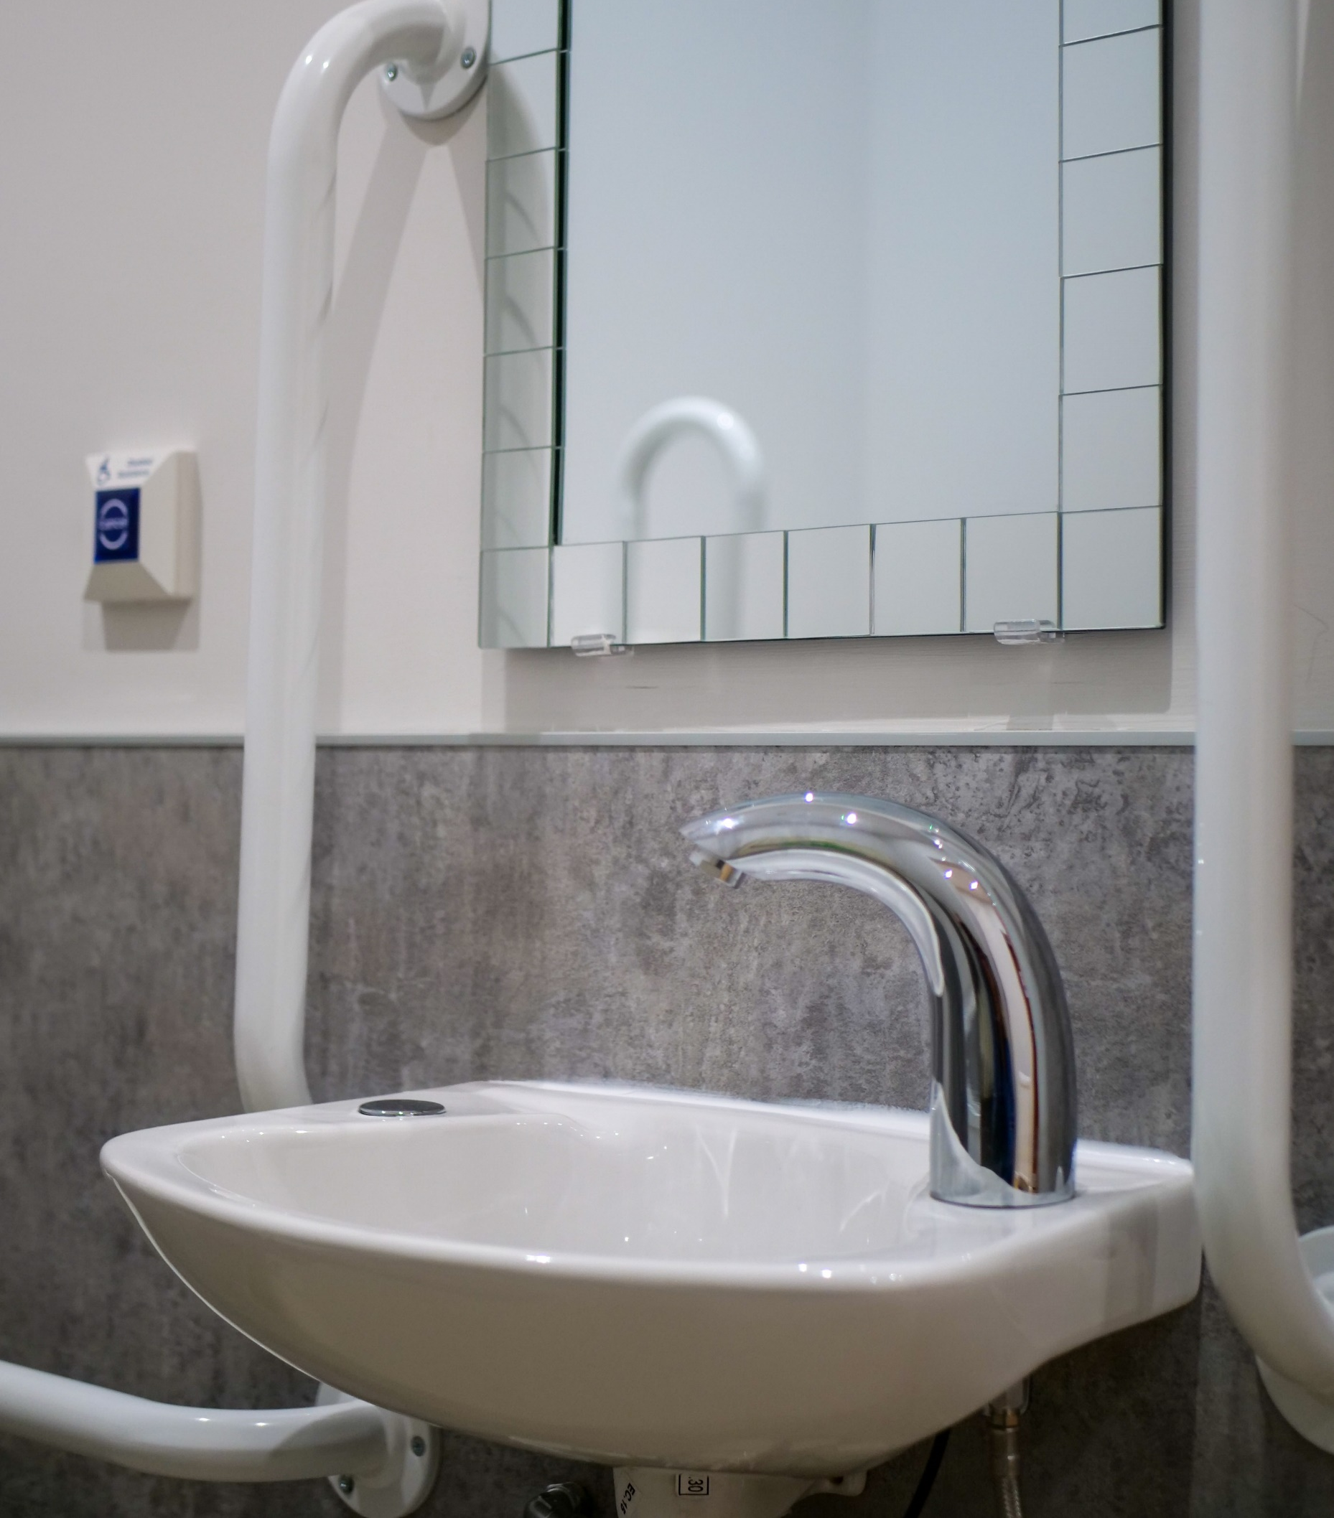
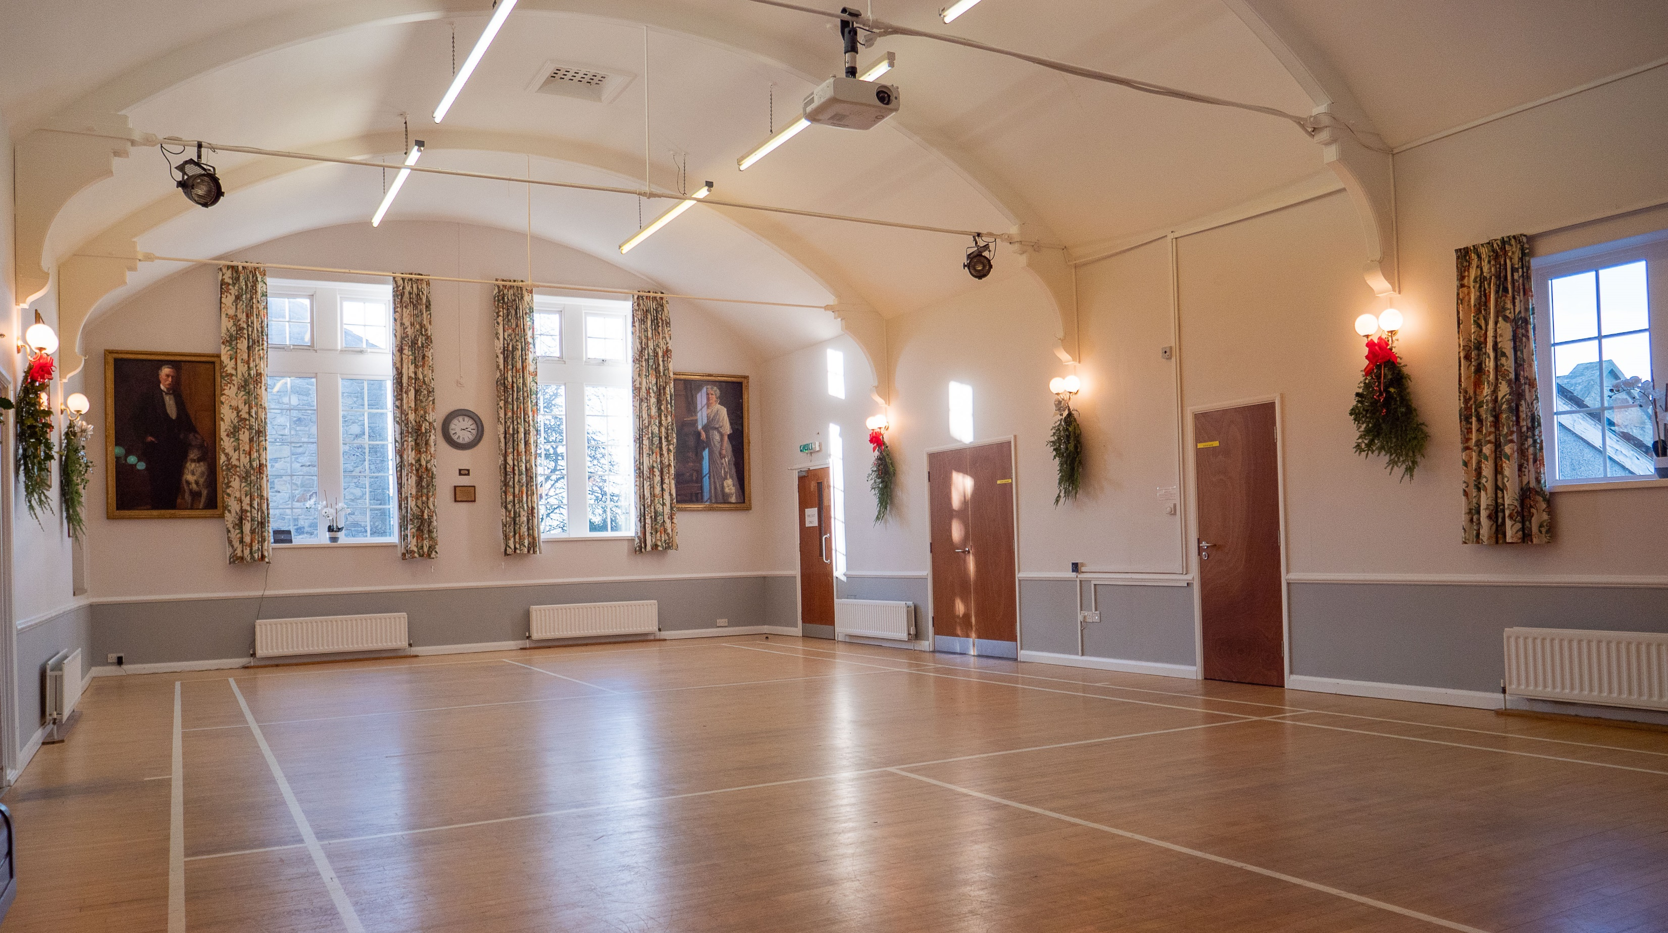
Slaley Commemoration Hall
Re-siting of damp toilets, from a basement to the foyer area

Slide 7
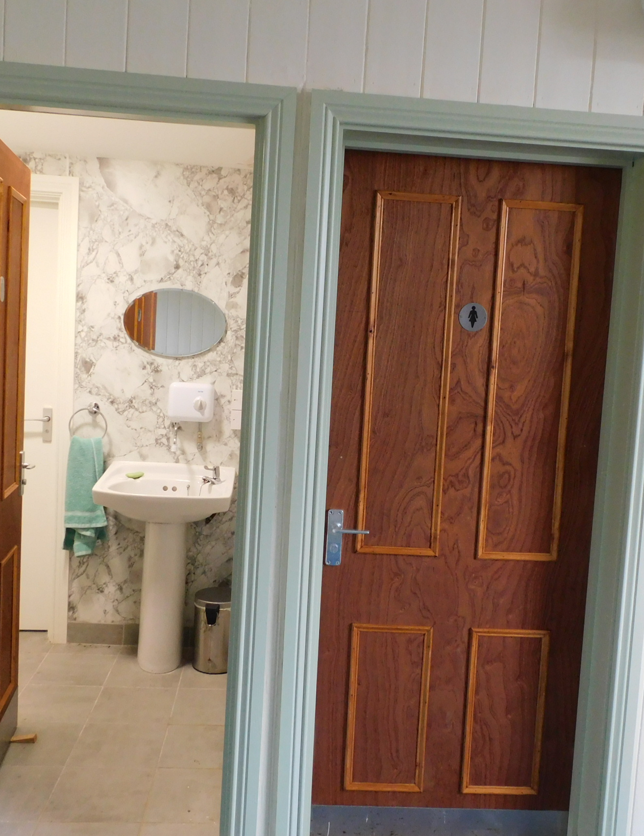
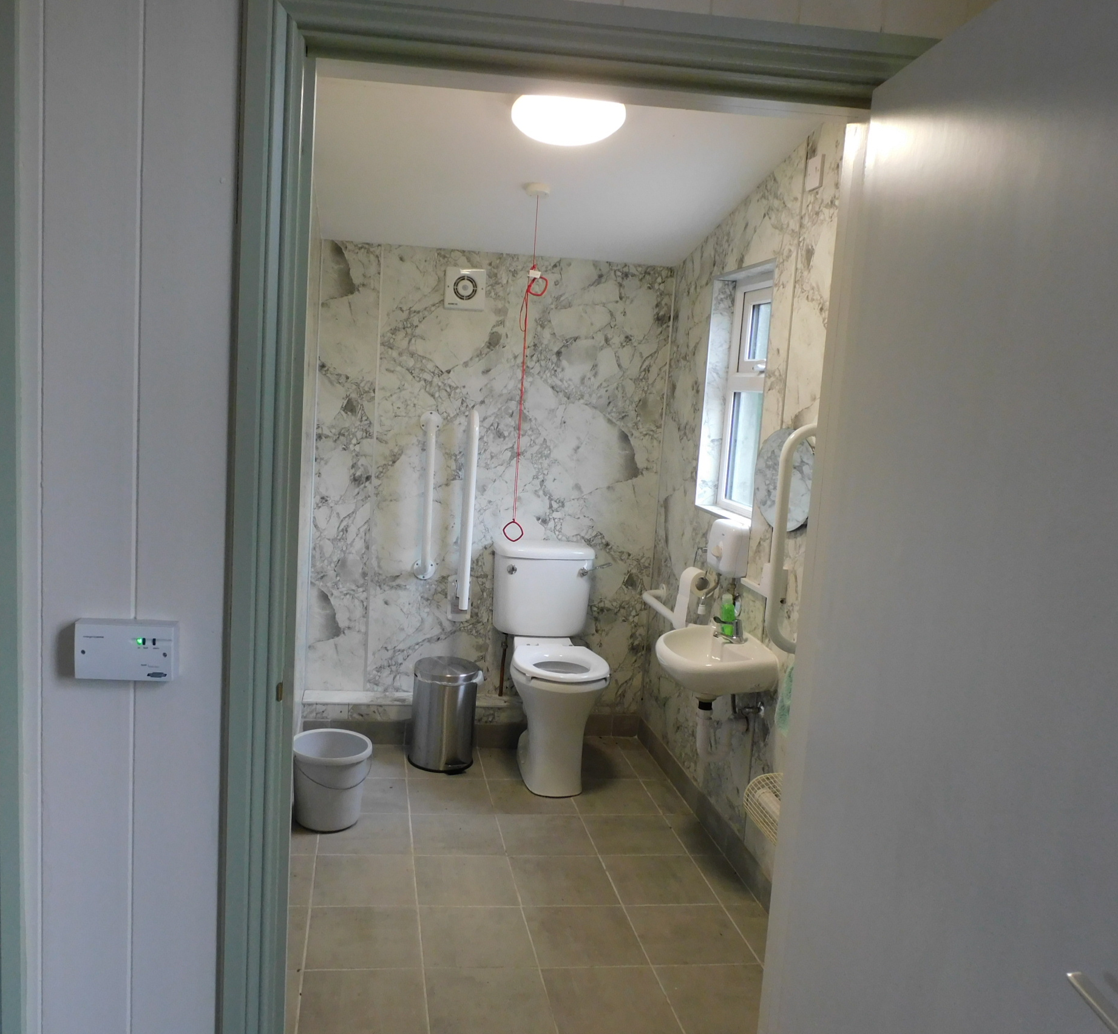
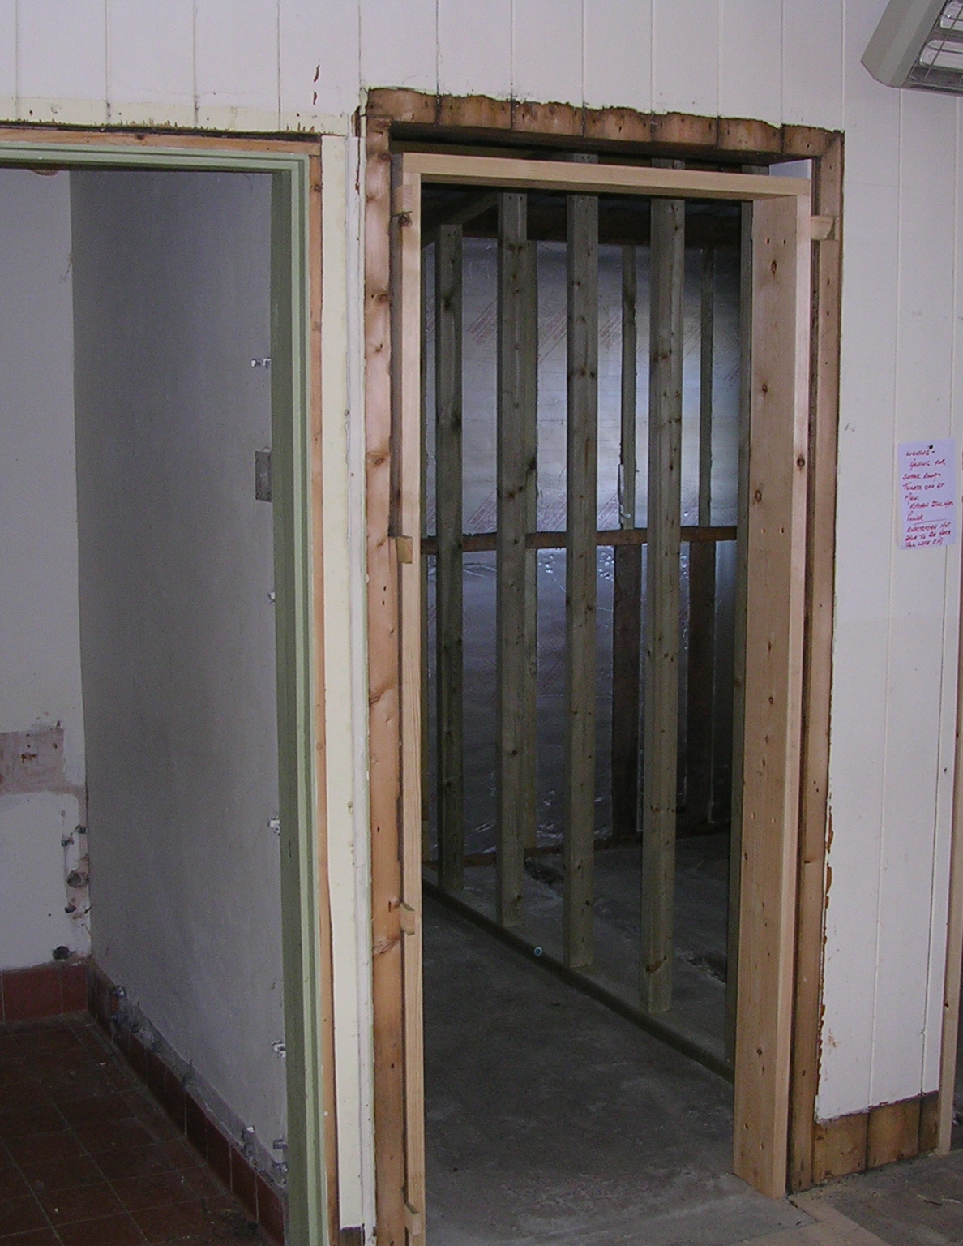
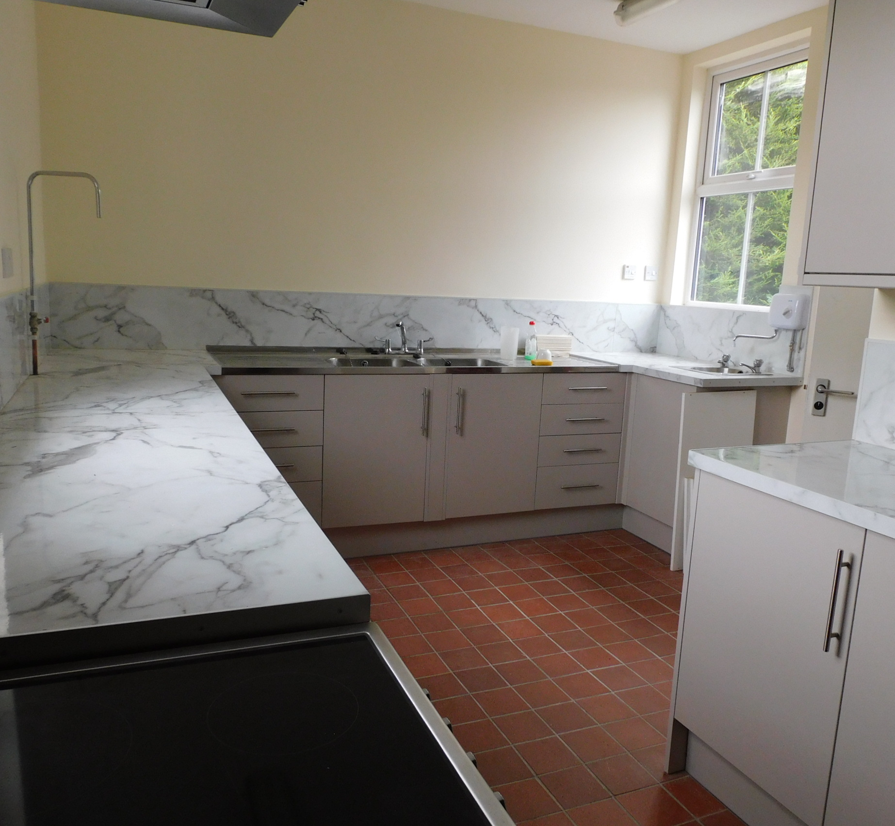
Corsenside Parish Hall
Upgrade of toilets, to include an accessible toilet, insulation of walls and roof space, kitchen upgrade and associated electrics.

Slide 8
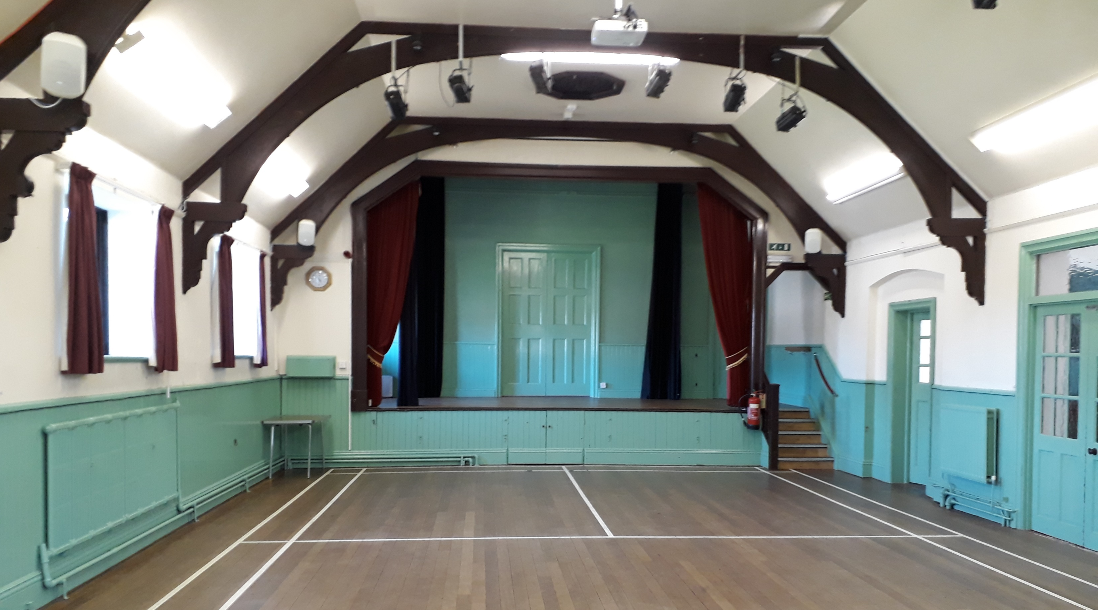
Humshaugh Village Hall
Servery installed into meeting room and refurbishment of main hall/flooring/re-decoration/glazing
Before

Slide 9
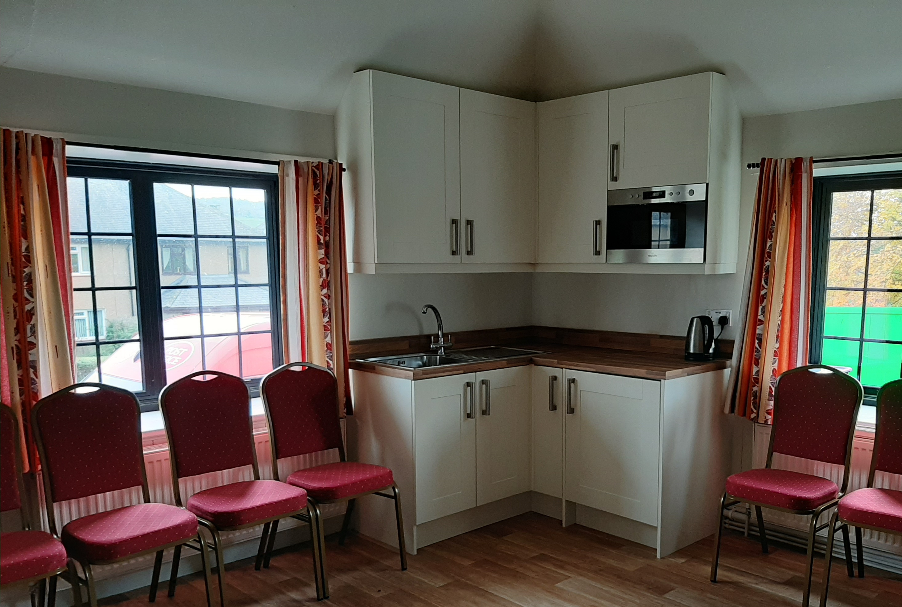
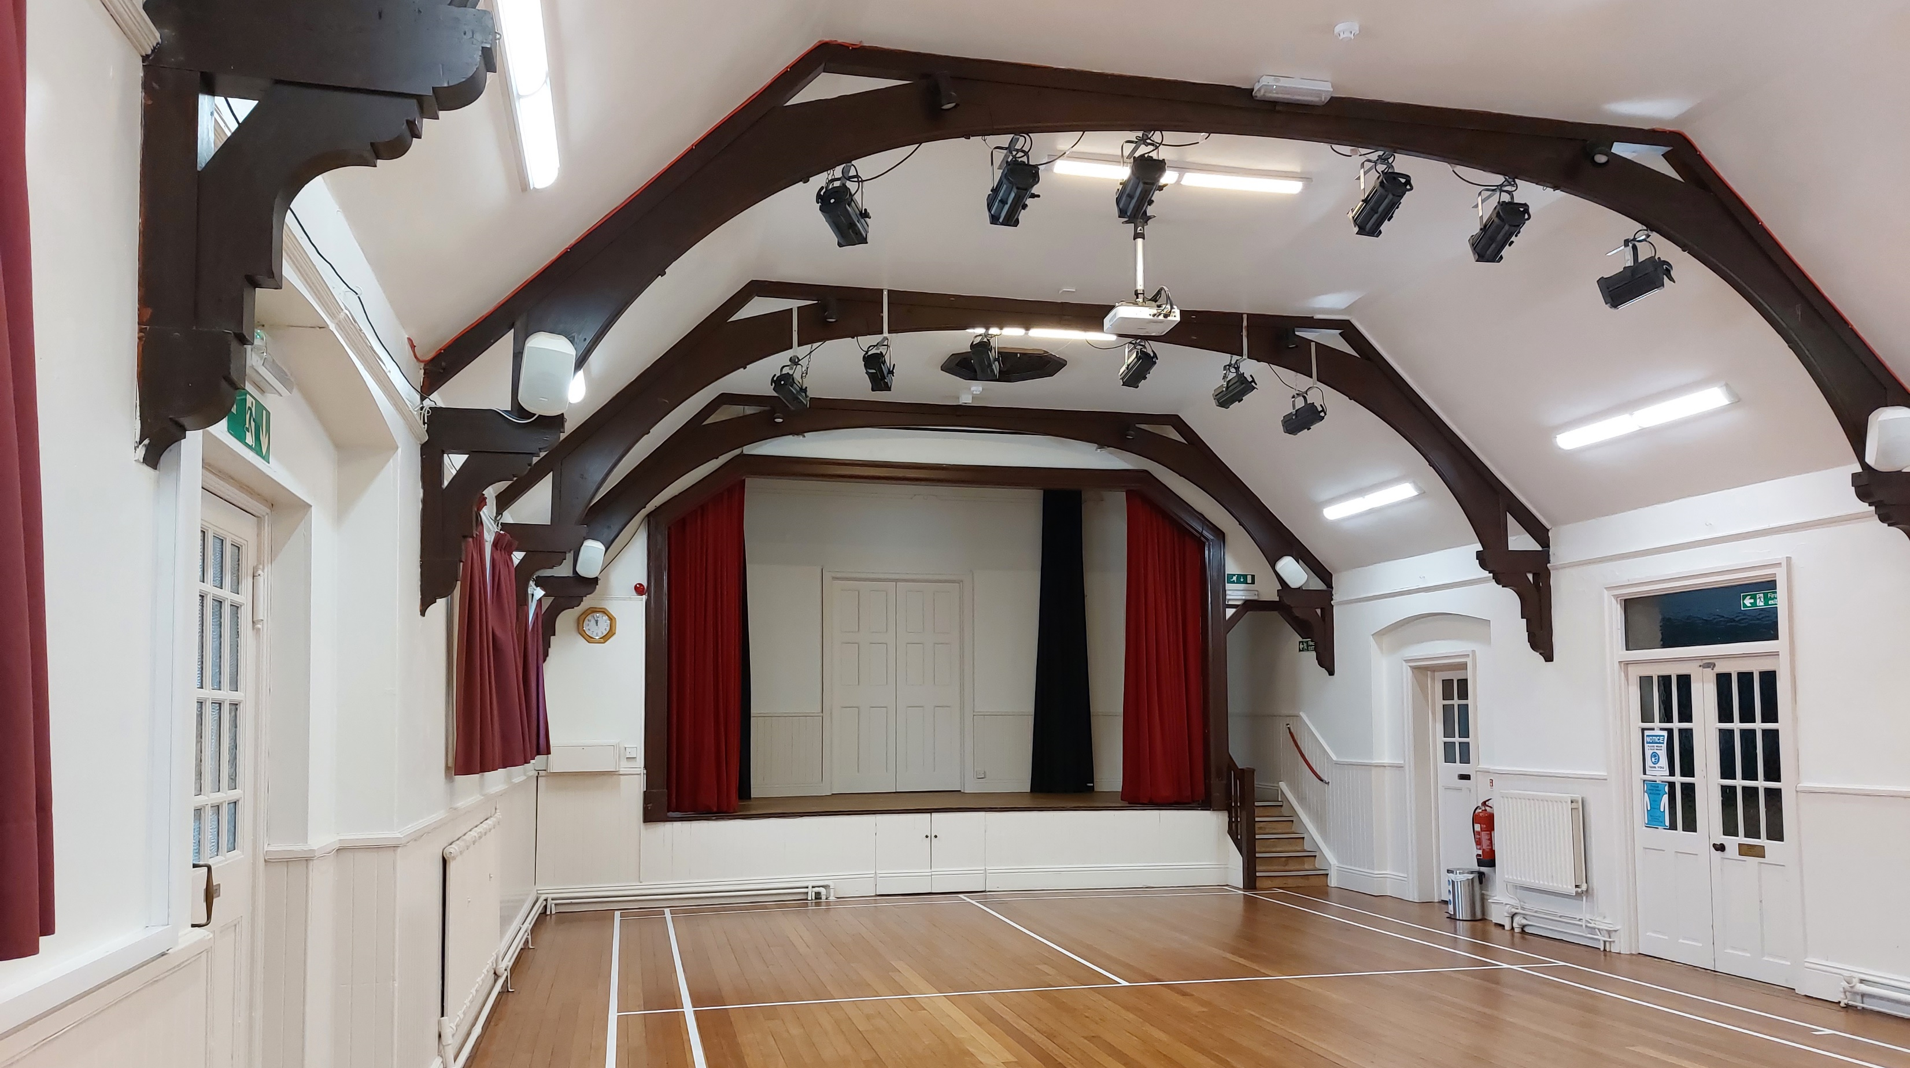
Humshaugh Village Hall
“The changes funded by the Lottery grant enabled us to complete our 10 year refurbishment project in four years! The hall now looks clean and bright and users have told us how much they now enjoy coming to the hall to enjoy the activities offered there.”
After

Slide 10
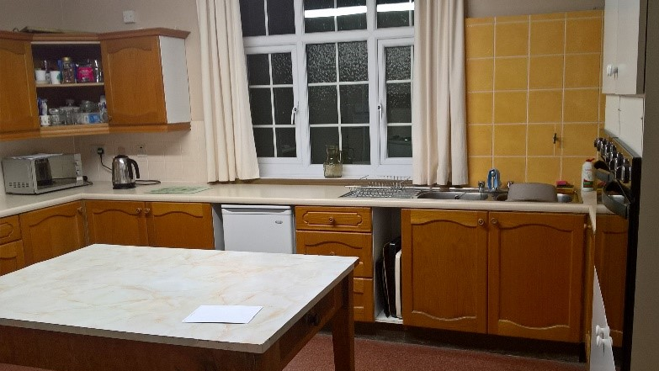
Heddon Knott Memorial Hall
Complete re-fit of old dated kitchen
“Before the lottery funded improvements, the kitchen was drab and depressing, very much a boil kettle, and leave room…”
Before

Slide 11
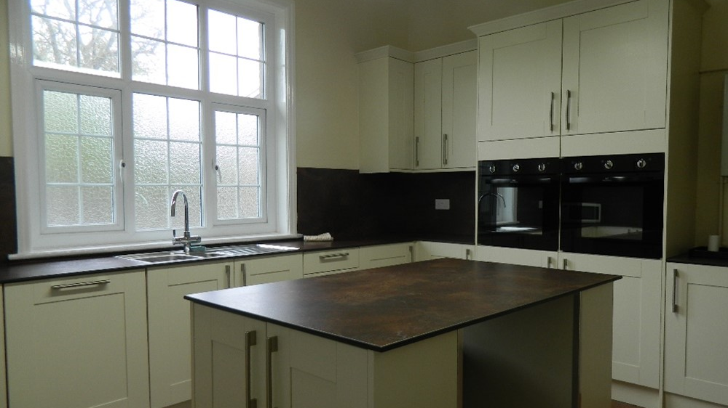
Heddon Knott Memorial Hall
Complete re-fit of old dated kitchen
“…..now it is light and functional, often filled with users and volunteers who stay to chat there. As a Trustee it has provided a welcome opportunity to improve the Hall and shift our focus from simply maintaining to grasping the future potential of improving our community.”
After

Slide 12
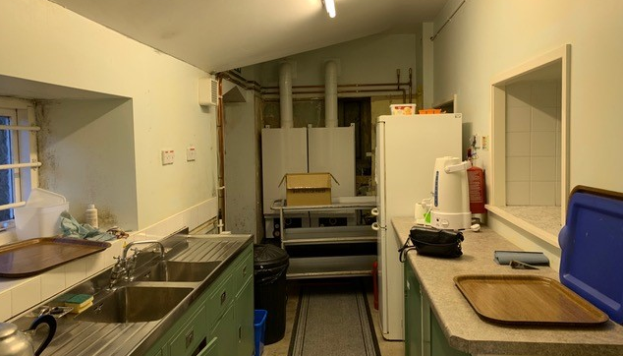
Lesbury Village Hall
Complete re-fit of dated kitchen and re-sizing of stage to create additional space in main hall.
“The old green stainless steel sink unit is now in Beamish Museum waiting to be installed as part of their 1950s display.
When we started our refurbishment programme we expected it to take us five years to complete.
When we were awarded Lottery money it meant we could create a fantastic new kitchen quite quickly, finish off the main hall work and put in new staging. “
Before

Slide 13
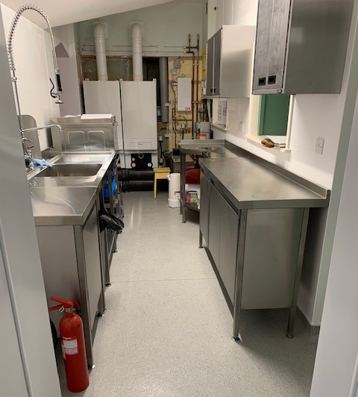
Lesbury Village Hall
Complete re-fit of dated kitchen and re-sizing of stage to create additional space in main hall.
“The hall has been transformed because of Lottery Funding and this has brought in new groups and lots of events. People in the community were beginning to do less and less in the hall because of its poor condition, now it is hard to find a free slot for new events. It really has become central to the community.”
After

Slide 14
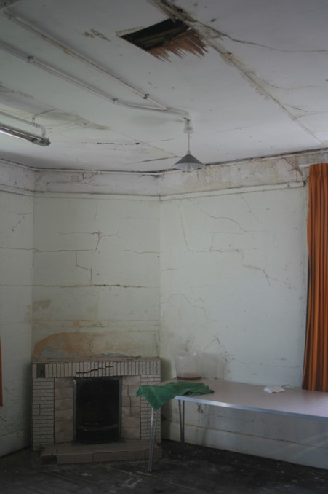
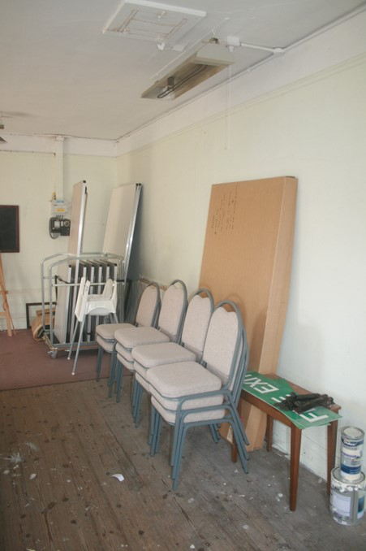
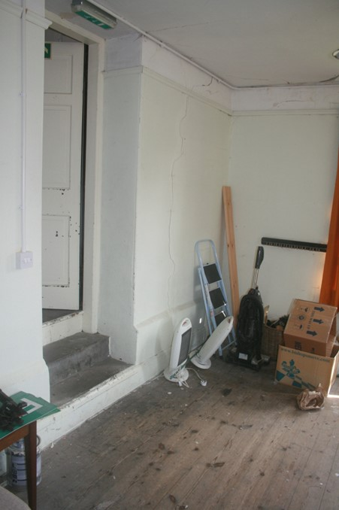
Crookham Village Hall
Rebuild of side room off main hall which had been disused. Enlarged door between the main and new hall.
Before

Slide 15
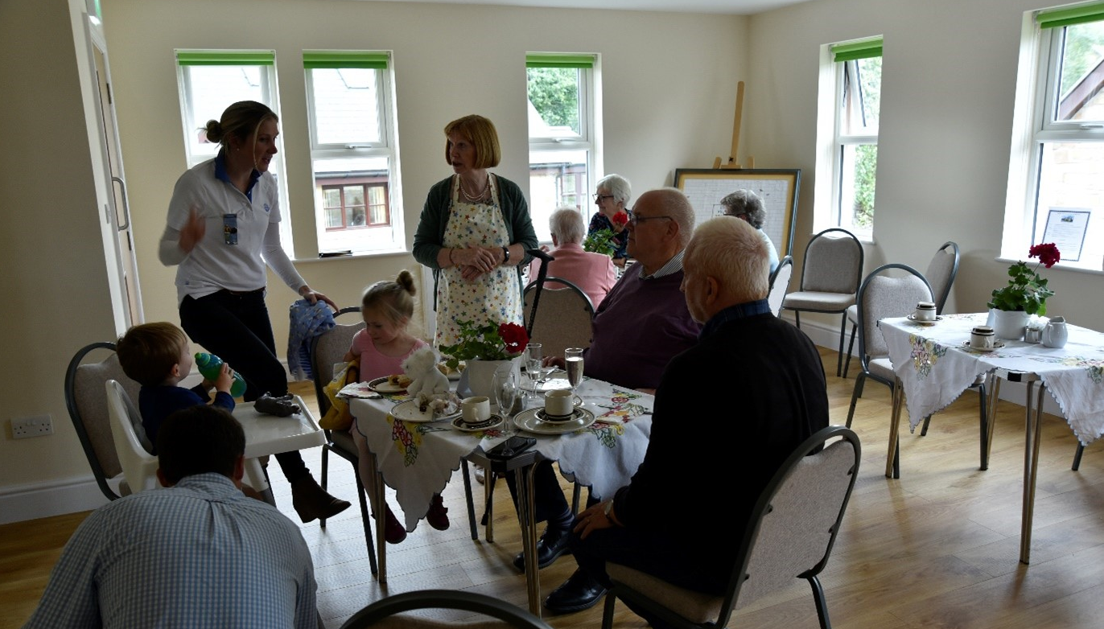
Crookham Village Hall
“This project has literally saved the original beautiful building from collapse. It has doubled the halls’ capacity, made it sustainable – but more importantly, has made it accessible to everyone.”
After

Slide 16
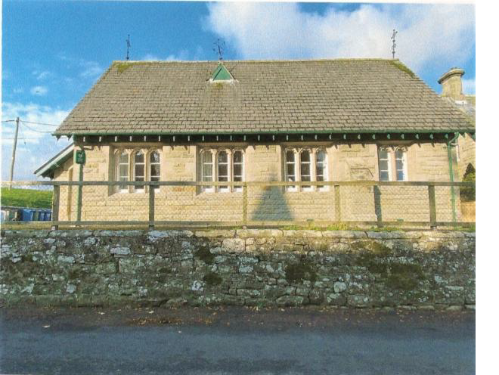
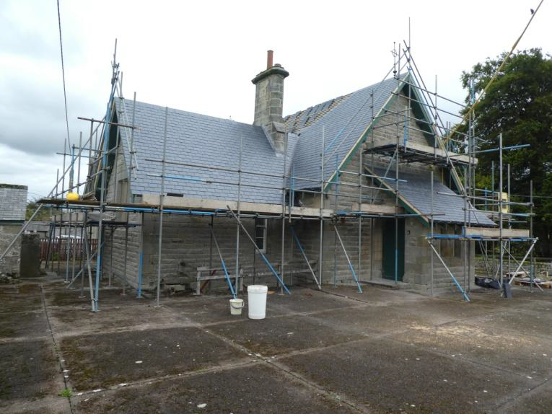
Hepple Village Hall
Replaced roof and improved the interior by raising the ceiling and exposing the east window.
Before
During

Slide 17
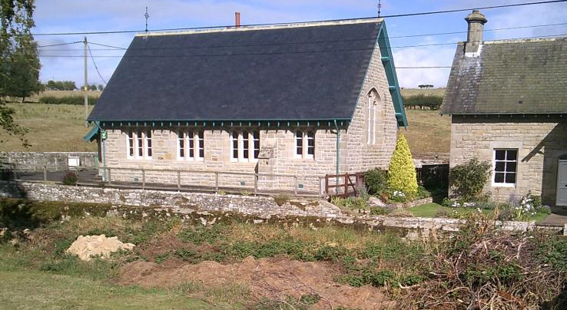
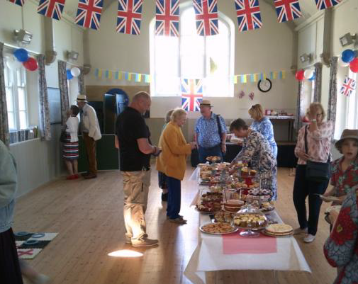
Hepple Village Hall
Replaced roof and improved the interior by raising the ceiling and exposing the east window.
After

Slide 18
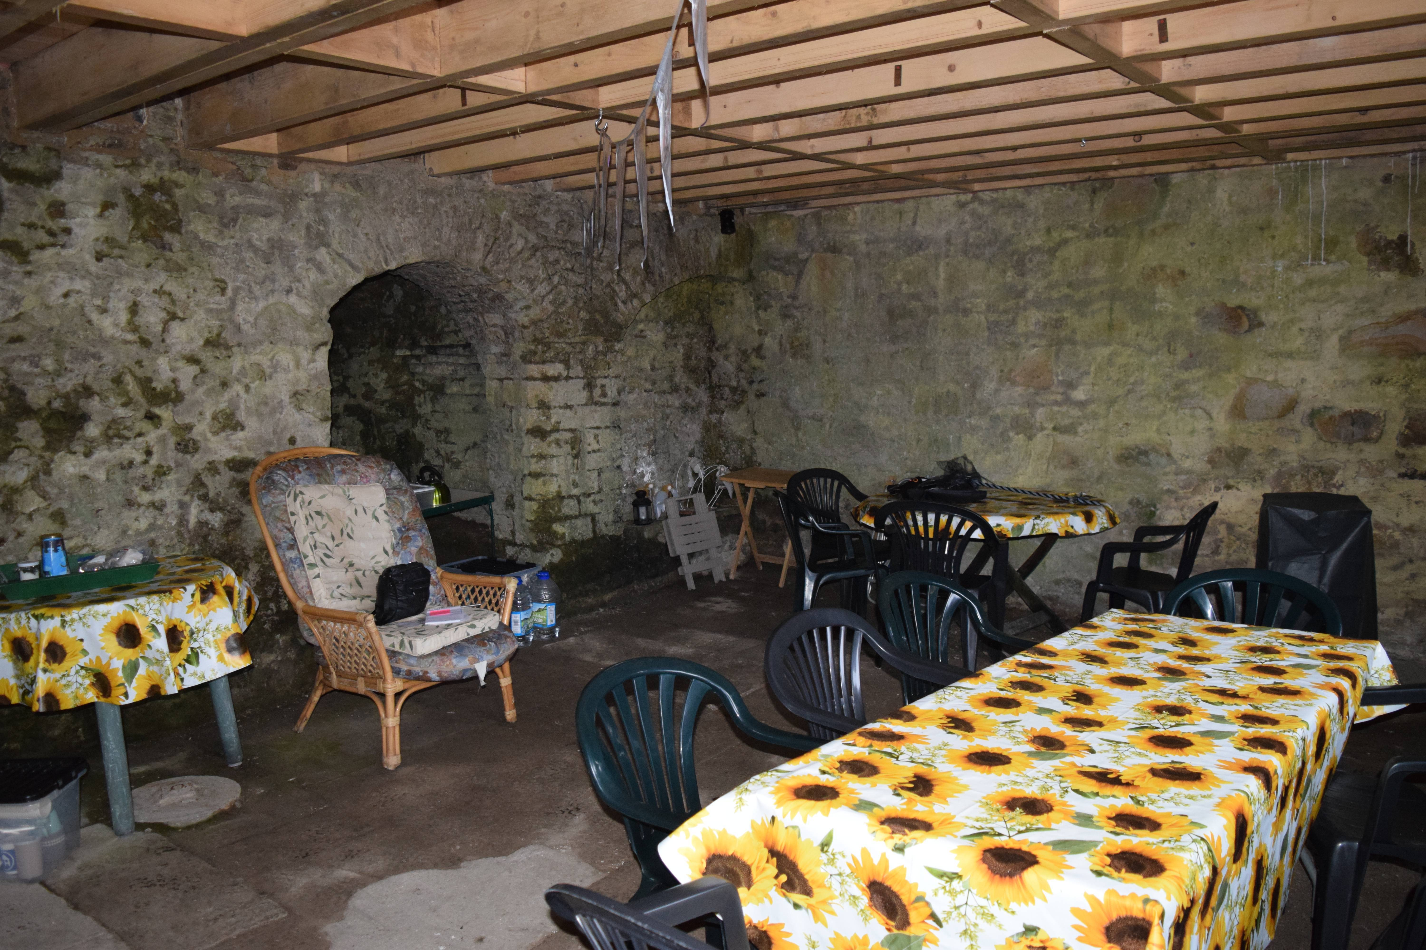
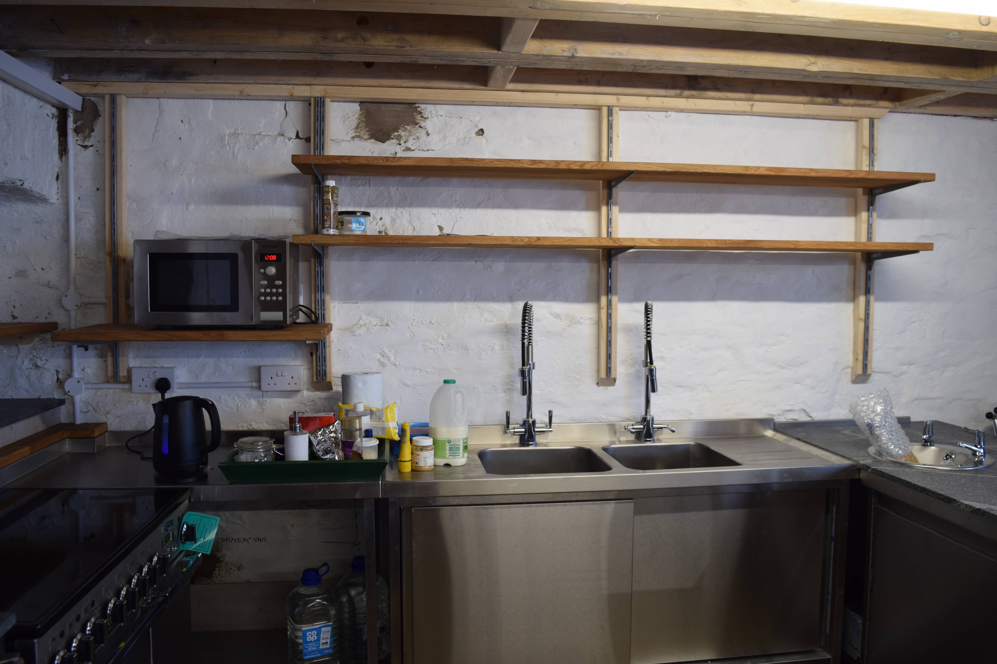
Carrshield Village Hall & Bunk Barn
This building, located on a remote hillside, has changed from a former lead mine into a village hall, arts centre and bunk barn. The added challenge was to remove the mine workings and install services. No water, no toilets, no electricity.
Before

Slide 19
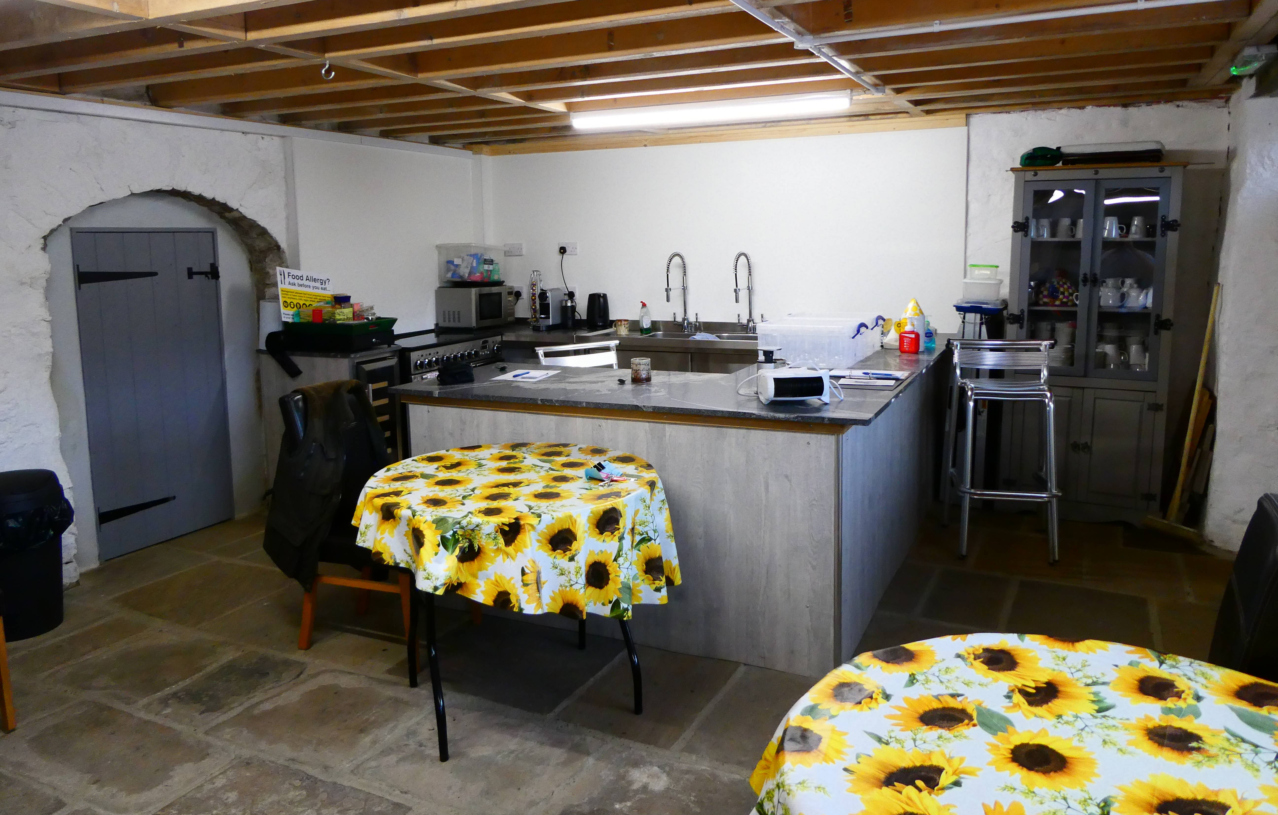
Carrshield Village Hall & Bunk Barn
Lottery funded the water connection, kitchen installation and tables and chairs, also saving it from the ‘at risk’ register.
After

Slide 20
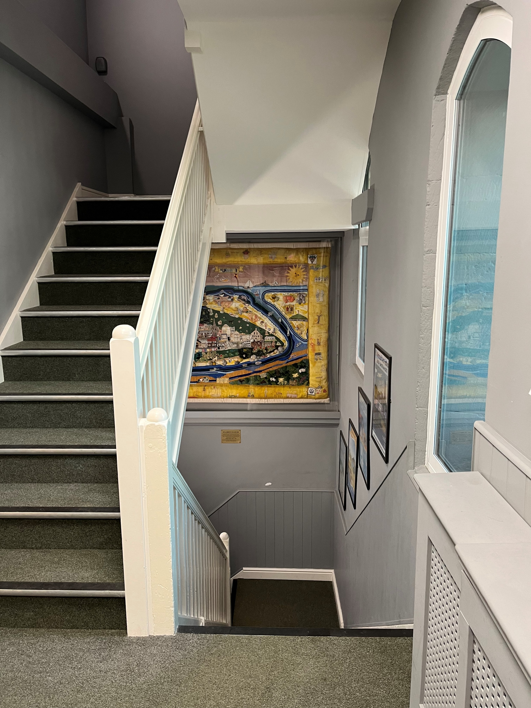
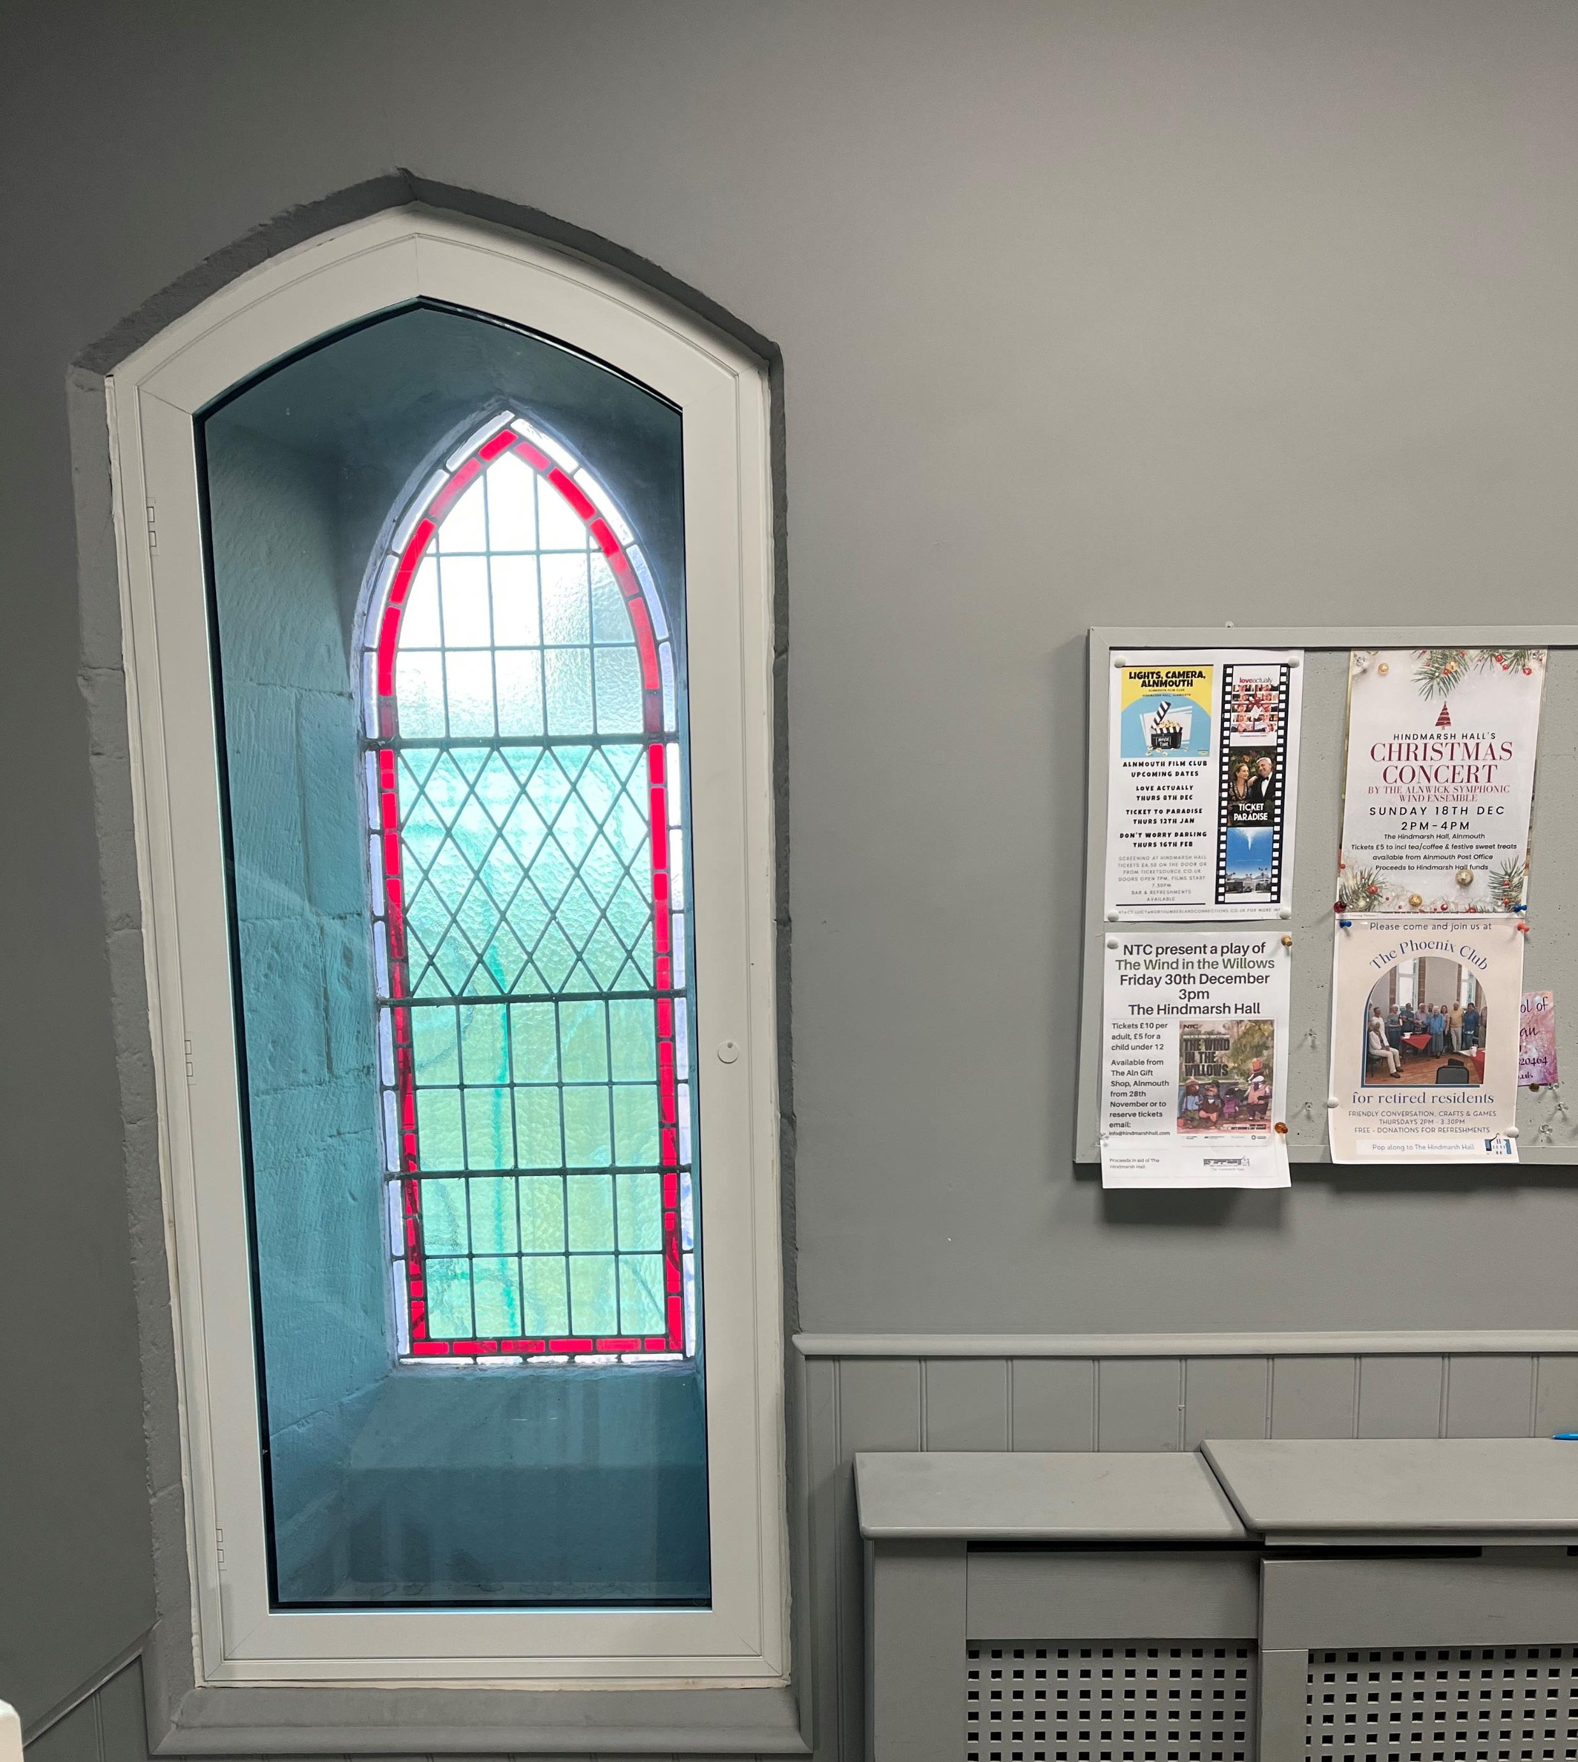
Hindmarsh Hall, Alnmouth
Fit double glazing units, new LED lighting, new ceiling and redecoration.
“The project made a cold and drab area much more attractive and cheaper to heat and light.”
After
Before

Slide 21
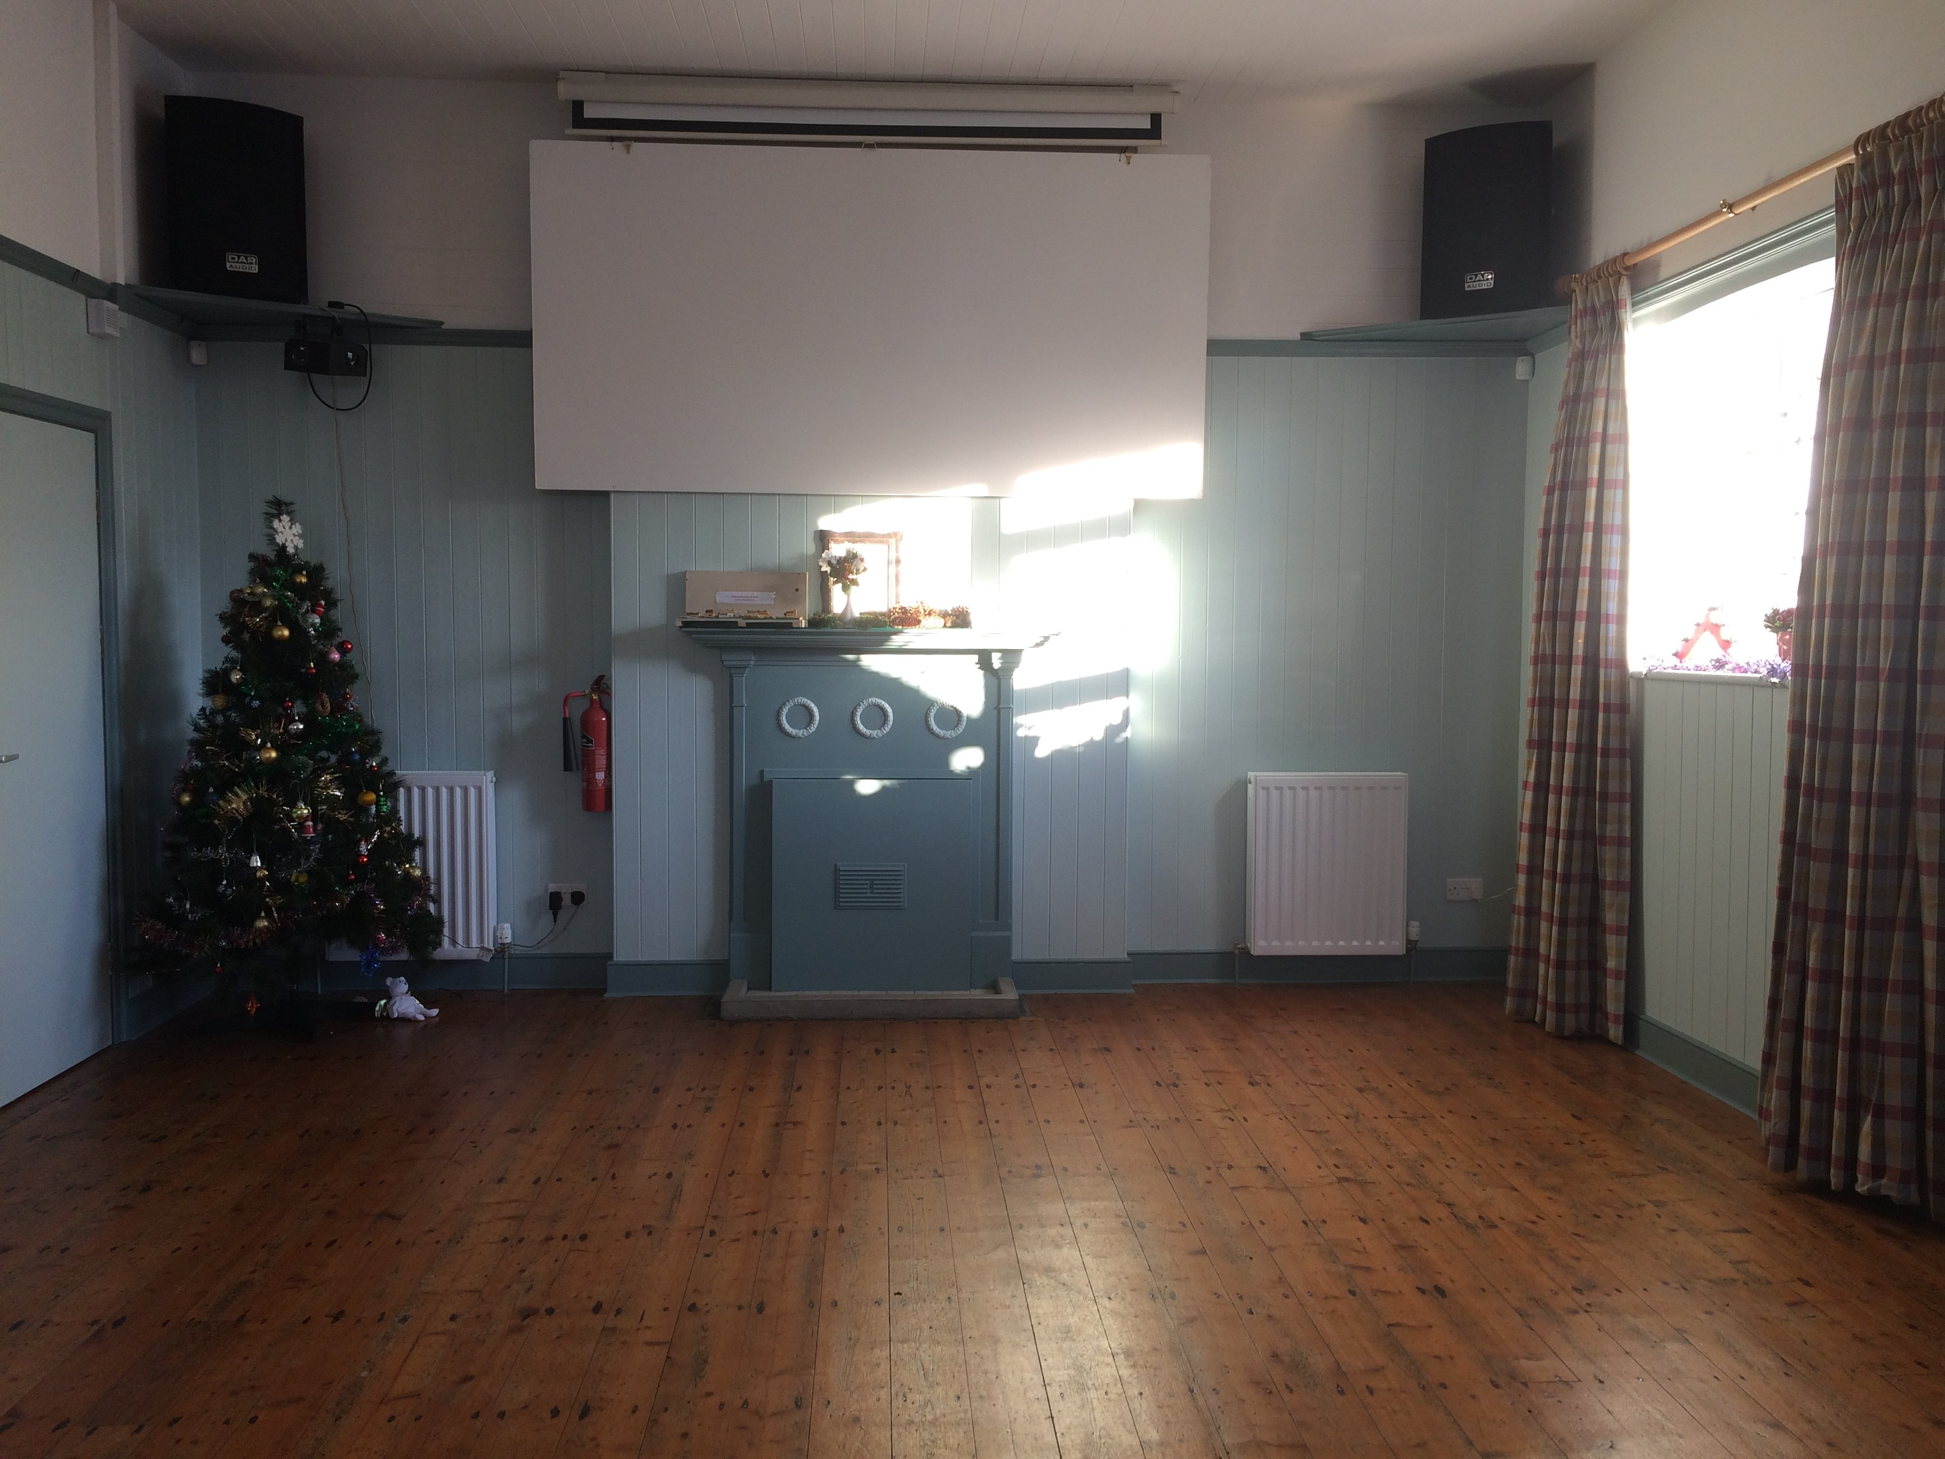
Branxton Village Hall
Improved the heating system, redecoration of the whole hall and improvements to fire safety and security.
“The hall now, very quickly, feels warm and welcoming and there are no longer complaints about the cold draughts.”

