Slide 1
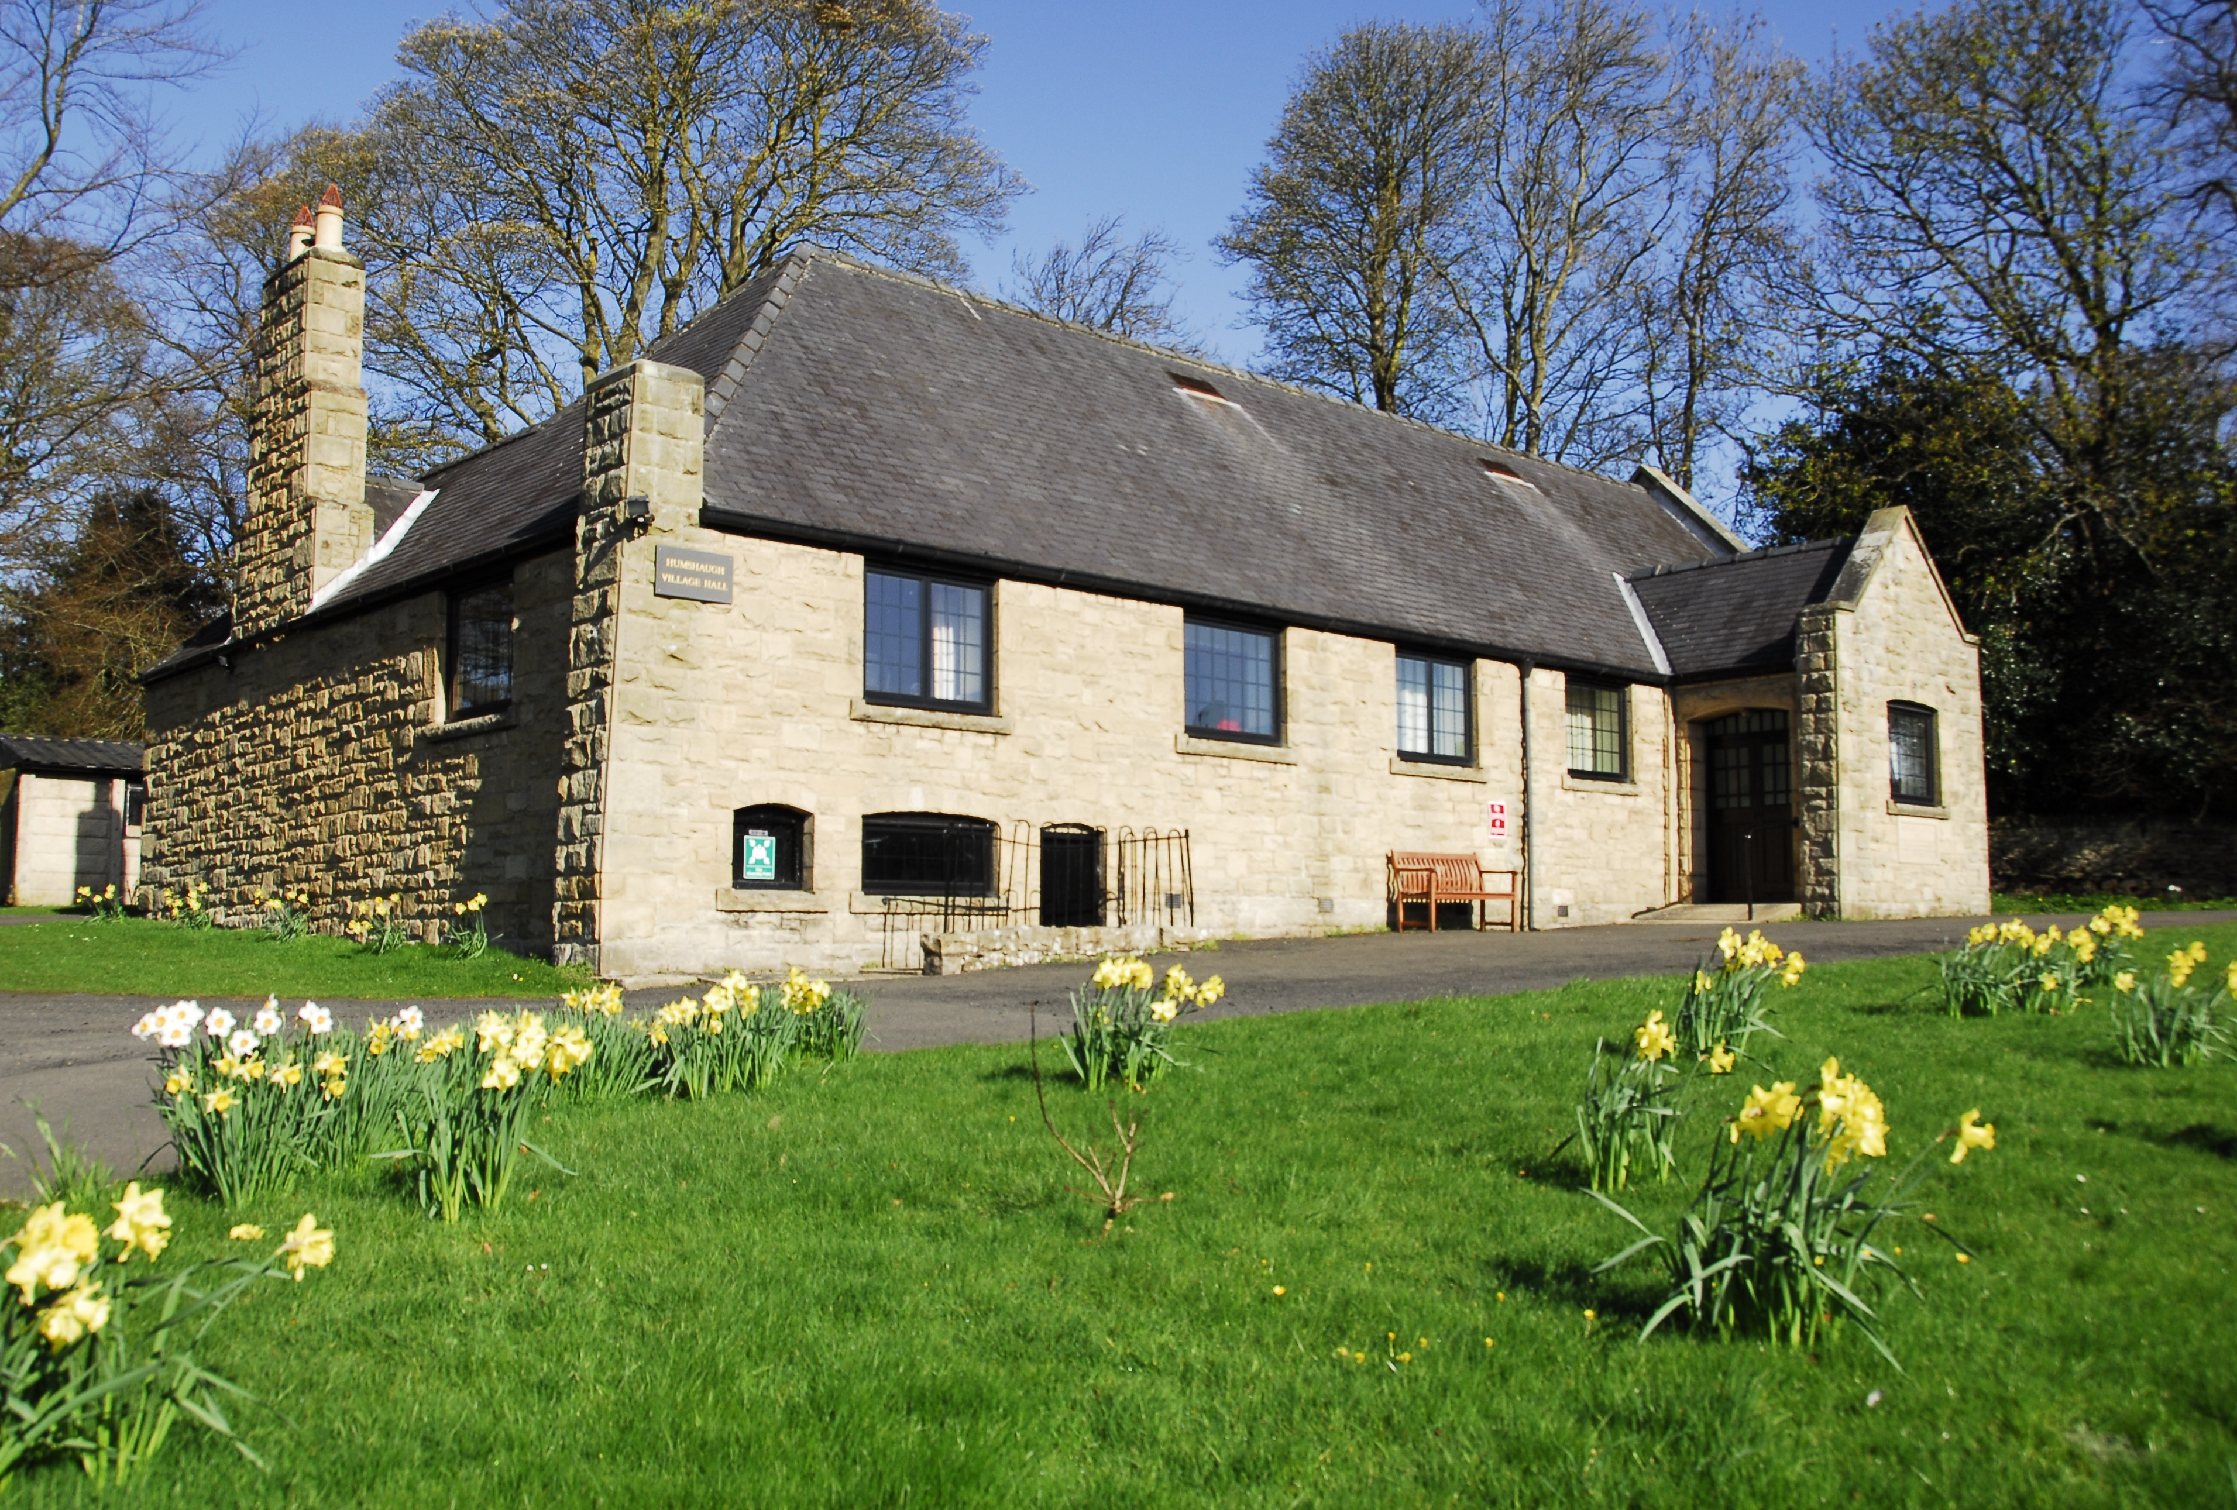
Humshaugh Village Hall
Diana Linnett

Slide 2
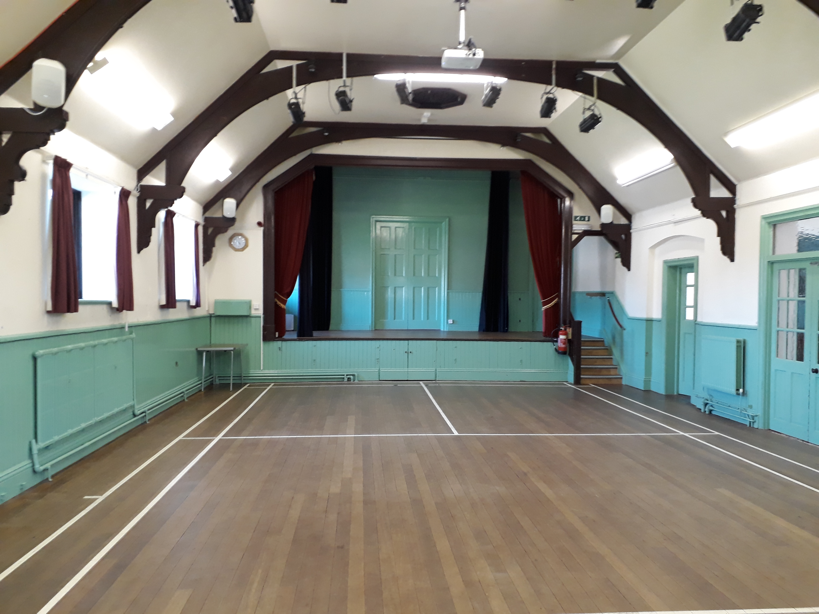
Background
Built in 1929 as Memorial Hall
Well maintained but in need of updating
But some H&S issues which needed addressing
Where to start?

Slide 3
First steps
Developed the plan
Listed the issues
Quotes
Documented the details
Kept going!

Slide 4
Finances – important points
Knew how much we needed – quotes etc
Knew why we need it – developed clear explanations of need and benefits
Gave ourselves time e.g. 10 year plan
Funding cut into bite size chunks
Chose grant giving bodies that are good fit

Slide 5
HVH Ten Year Plan – Phase 1
Resurfacing of external areas
Replacement of chairs
Provision of blackout blinds
Redecoration of all internal areas
Replacement of old strip lights with LED strips
Total cost of Phase 1: £32775 funded by external grants, HVH funds and fund-raising events

Slide 6
Our Ten Year Plan – Phase 2
Side room refreshment area – new kitchen units, washable vinyl flooring
Roof insulation to main hall
Replacement of stage curtains and runners (fire retardant)
Sand and reseal of hall floor
Total cost of above £11255 – funded by Reaching Communities/CAN grant

Slide 7
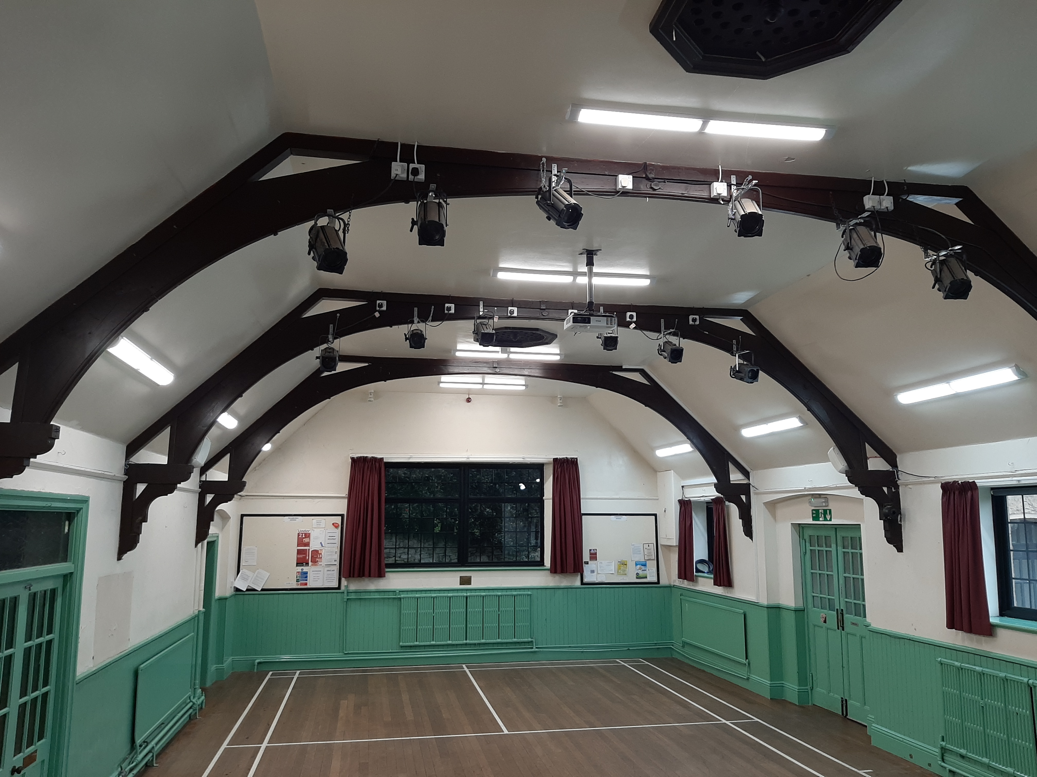
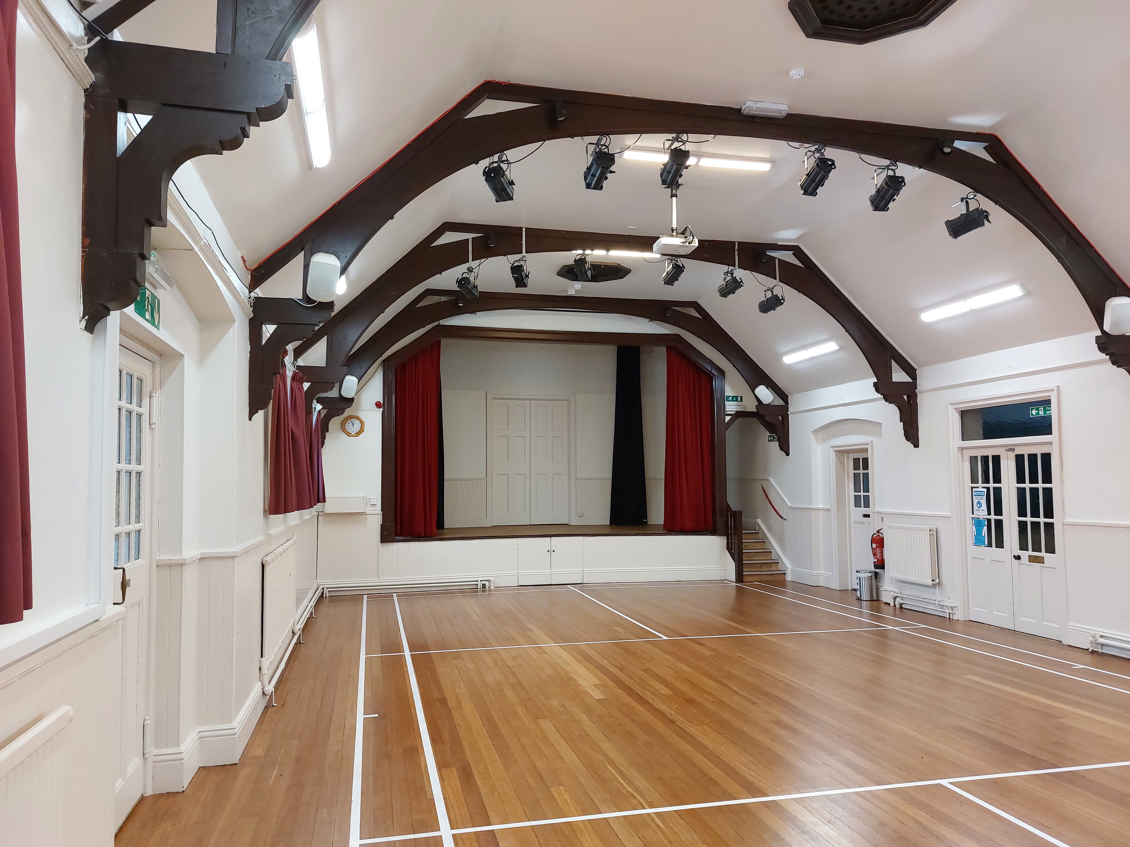
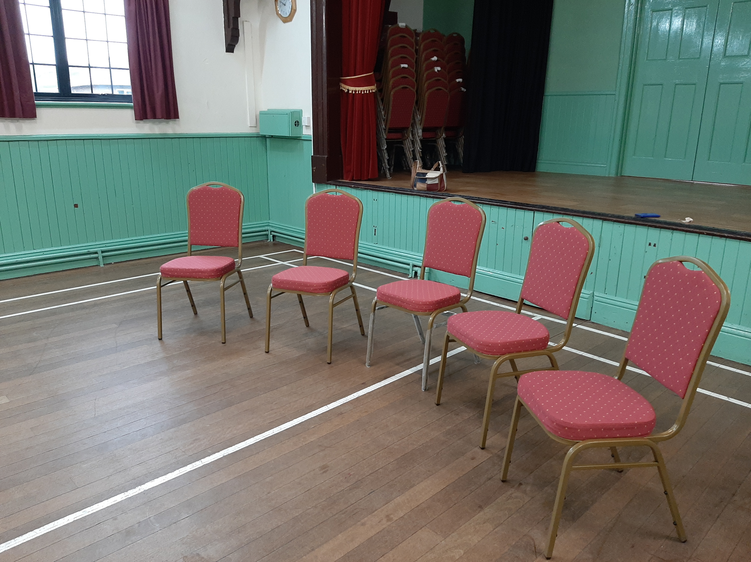

Slide 8
Work outstanding
Replacement of front and rear doors to hall due to be undertaken in April 2022 – delayed due to Covid and funded by HVH.

Slide 9
Implementation of Plan
Most of the work undertaken during various lockdowns
Hall re-opened for limited activities from May 2021
Welcome Back day in July 2021!
Stands for various village groups
Tea and cakes outside in the open
First step towards social integration

Slide 10
New post-covid activities
Regular coffee mornings to encourage people to meet with others – run by different village groups
Computer café – three grant-funded laptops to encourage and support people who had been isolated during lockdown because of poor digital skills, mentors help with new and ongoing problems and enjoy coffee and chat! Digital and Social inclusion!

Slide 11
Ten Year Plan
Should have been Four Year Plan!
Hall now in excellent condition and well used
Waiting for the next new idea!

