Slide 1
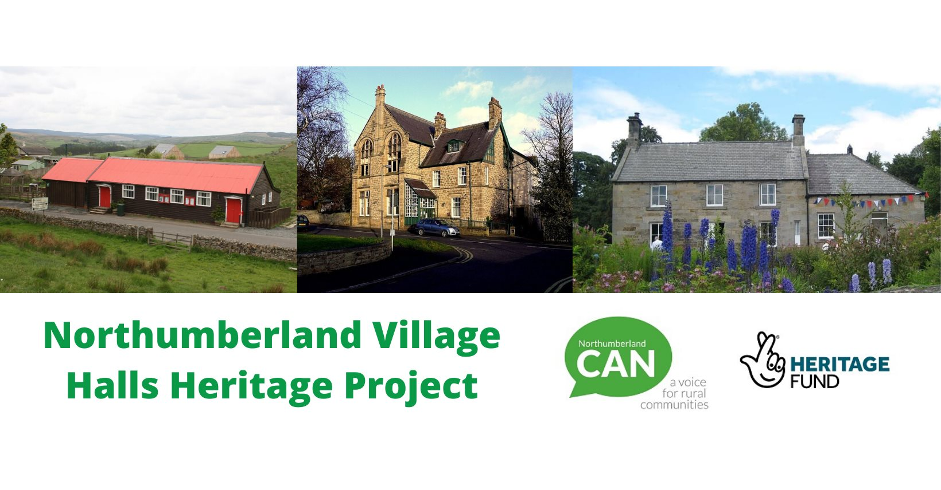

Village Halls Heritage project

Slide 2
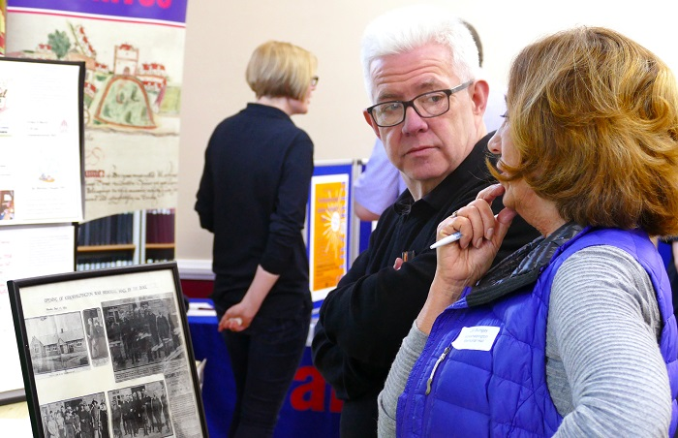


Background to project
CAN awarded £84,600 grant for 2-year project celebrating the history of village halls in Northumberland.
Project will preserve, record and share the heritage of Northumberland’s Village Halls.
CAN working in partnership with Northumberland Archives and 30 selected village halls.
Project been on pause during pandemic, now starting back up.
Notes:
Funded by the National Lottery Heritage Fund
Initially had 30 halls interested, some for year 1 and then year 2.
However we’re re-evaluating that list, checking in with halls to see if still interested, may do a waiting list or help interested halls to things on a smaller scale.

Slide 3
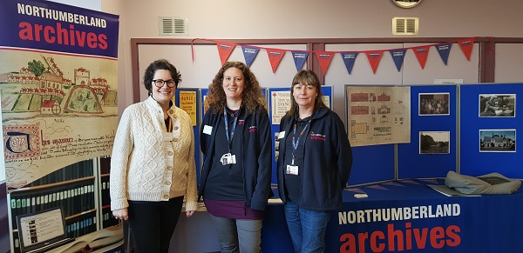
Notes:
There was one visit to Northumberland Archives in November . All participants reported the visit as being very worthwhile. . After the pause due to Covid, new visits are planned.
Through cross-generational work it will combat isolation amongst the elderly, educate the young and strengthen community cohesion.

Slide 4

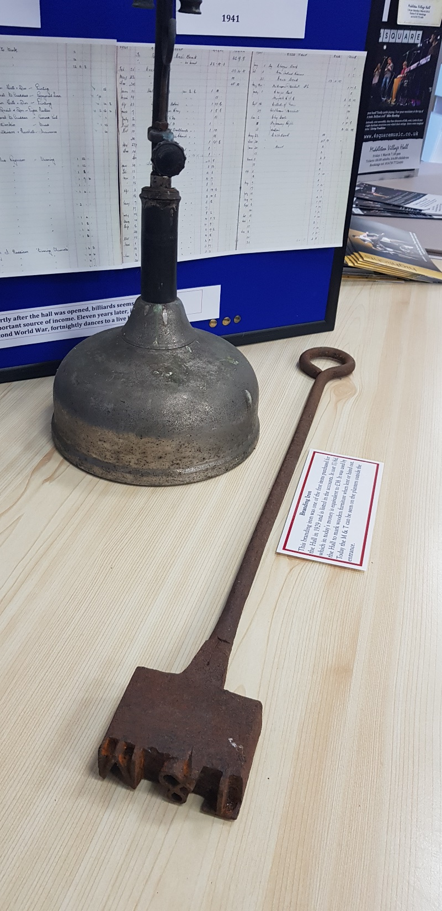
What we’ll be doing
CAN and Northumberland Archives will work closely with village hall committees, local residents & community groups.
We will recruit, train and support local volunteers to:
research history of buildings
collect oral histories about the role village halls have played in local life
conserve and archive documents, photographs and artefacts currently held by participating village halls, local residents and CAN
carry out educational / cross generational work with schools and young people’s projects.
Notes:
Been on pause due to Covid
Through cross-generational work it will combat isolation amongst the elderly, educate the young and strengthen community cohesion.

Slide 5
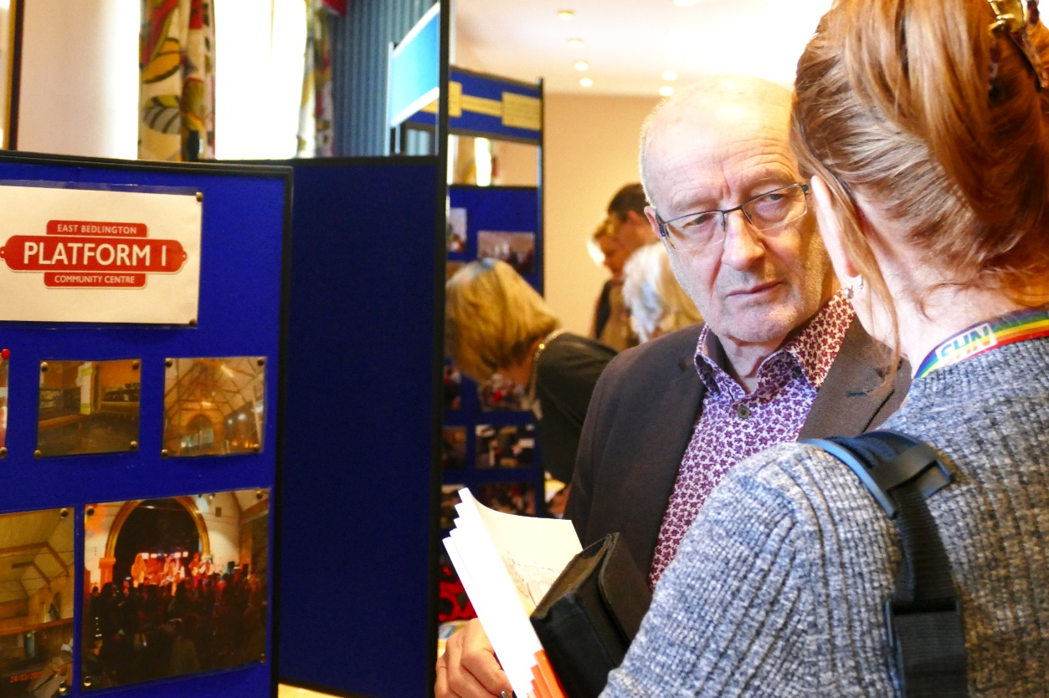
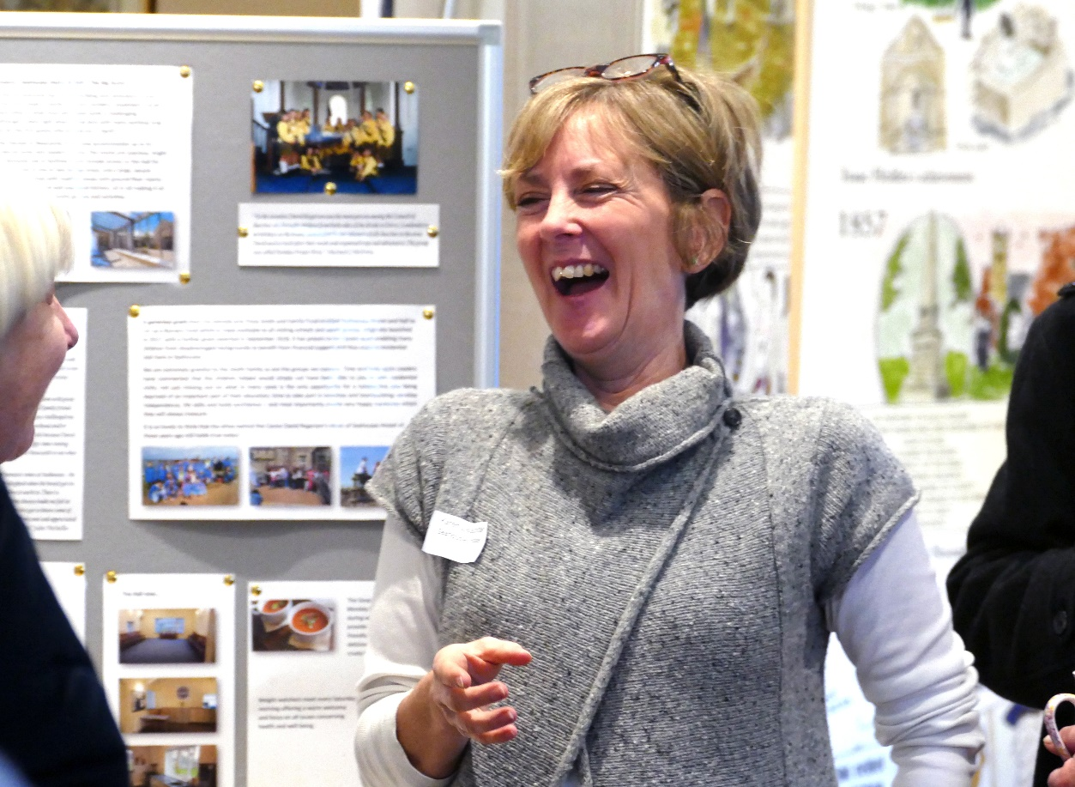
We will interpret the findings of this work by:
Mounting an exhibition and taking it on a tour around village halls.
Creating a book & website.
Providing participating village halls with resources for local use.
Notes:
Been on pause due to Covid
Through cross-generational work it will combat isolation amongst the elderly, educate the young and strengthen community cohesion.

Slide 6
What's Happened Recently exhibition
14 Village Halls have undertaken Oral History Training
Lesbury village Hall- have recorded 5 oral histories
Stamfordham Village Hall- have been practicing interviews on steering group members and have a plan and timeline for researching the documents and oral histories they want to show at events.
Stocksfield Village Hall – Currently have 6 people involved. They are searching for documents, starting to put together a newsletter and talking to representatives of user groups.
Breamish Village Hall – Have been finding prints , discovering more of the hall's history, Identifying people to interview , even those who no longer live locally. They have developed information sheets for sharing items etc.

Slide 7

What has happened recently
A visit to Northumberland Archives in November and plans for more
Toolkit for Village Halls to use is being updated and will be shared soon
Visits started to all 15 Village Halls who are involved in Year 1.
Steering Group has met regularly
Continued publicity including updates to Facebook and a planned newsletter

Slide 8

Get involved!
Join our Facebook page and share your hall stories, photos and memories:
www.facebook.com/groups/villagehallsheritage/
Volunteer for training in oral history and archiving – dates TBC soon!
Start gathering your old photos and documents ready for archiving and identify local people interested in sharing stories.
Promote the project to your community, are there events/coffee mornings you could piggyback onto? Look out for posters and leaflets from us soon.
Put the heritage project on your committee meeting agenda to discuss and get everyone behind.
Keep up to date by visiting our project page:
www.ca-north.org.uk then search for ‘village halls heritage’
Sign up to CAN Enews
Notes:
Been on pause due to Covid
Through cross-generational work it will combat isolation amongst the elderly, educate the young and strengthen community cohesion.

