Slide 1

Village Halls Week
Celebrating Digital Inclusion Volunteers
Marc Johnson – Community Development Officer

Slide 2

Project Background
2021/22 CAN and Newcastle University carried out research ‘The role of Northumberland Village Halls in digitally connecting rural communities’
2022/23 Commsworld bid for Broadband Infrastructure contract from NCC, included a social value element. CAN & NICRE involved in the bid at an early stage.
2024 Three-year project funded via Commsworld launched in October
Key aspect of project:
Recruitment and support for Volunteer Rural Digital Champions

Slide 3

Why Digital Inclusion Matters
Digital access is essential for modern life: communication, services, and opportunities.
Many people, especially in rural areas, face barriers to getting online.
Our volunteers are the bridge to a more connected community.

Slide 4
The Role of Digital Inclusion Volunteers
Helping people gain confidence with technology.
Troubleshooting issues with tech.
Supporting access to essential online services.
Reducing social isolation through digital skills.

Slide 5
Volunteer Digital Champions
7 Digital Champions
Newton on the Moor / Swarland
Shilbottle
2 x Warkworth
2 x Morpeth
Hexham
Need more in North and West – can you help us to recruit?

Slide 6
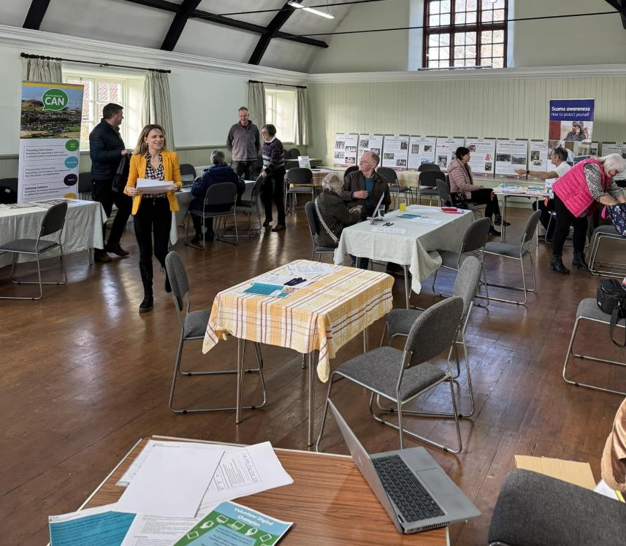
Village Halls as Digital Hubs
Techy Tea Parties
Shilbottle, Newton on the Moor, Netherwitton, Wylam & Thropton.
Digital Session
Warkworth Village Hall – Coffee & Connect
Link with Activities
Coffee mornings, Warm Hubs etc..

Slide 7
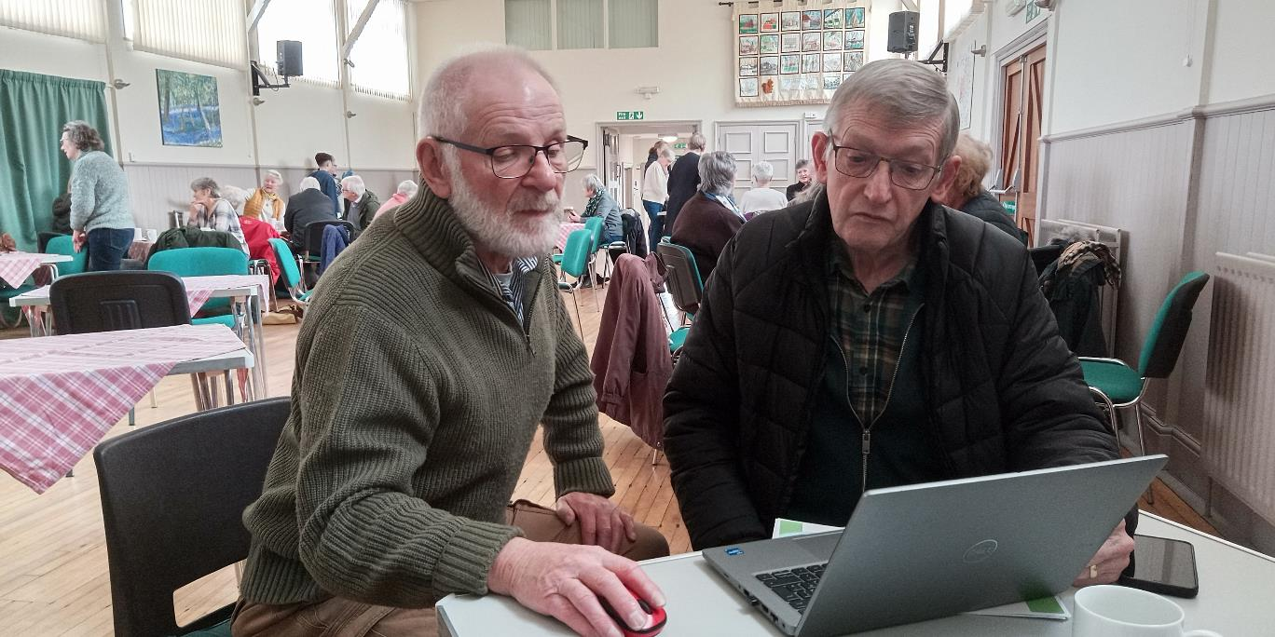
Volunteer Success Stories

Slide 8
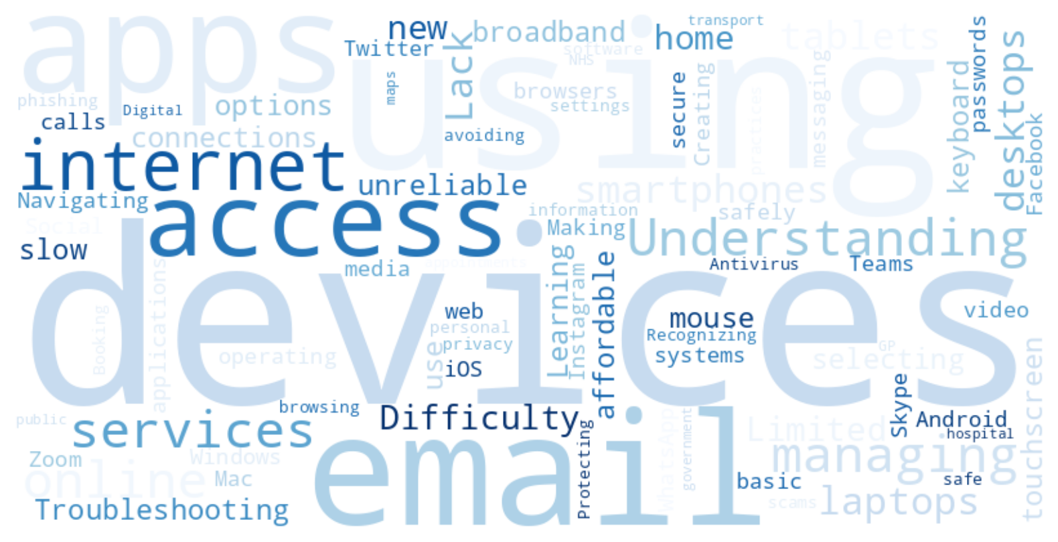
Volunteer Success Stories

Slide 9
Call to Action
1. Could your hall support some digital activity?
2. Could you help to recruit a digital champion?
Contact
Marc Johnson marcjohnson@ca-north.org.uk
07477 961096

