Slide 1
Alan Gerono
Volunteering Development Officer
Community Action Northumberland

Slide 2
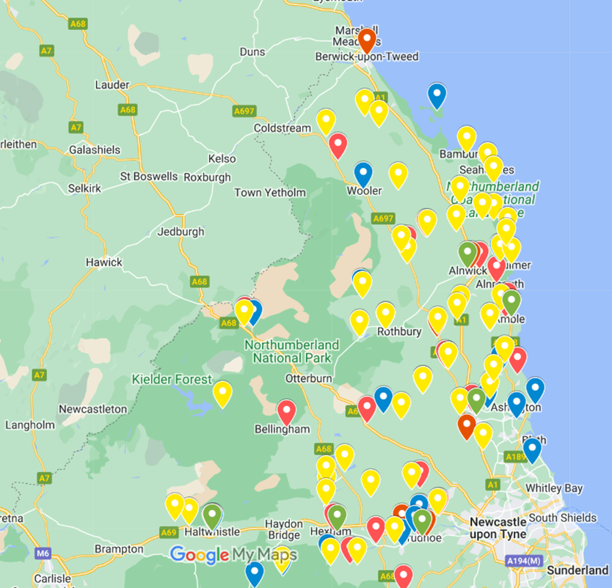

Volunteering development support in rural Northumberland
From Byrness to Alnmouth
From Lindisfarne to Snods Edge
Notes:
Community Action Northumberland has a long history of supporting rural communities and groups. Over the last 12 months or so, we have been able to give special attention to volunteering development. This has involved many things. We have helped small charitable groups – including village hall groups of course – to define and create volunteering opportunities. We have also provided a wide range of training and awareness sessions to help village hall volunteers to manage their own affairs and to provide valuable services to the community. We have been able to give information and advice to help volunteers run a charitable organisation and community activities. And we have been eager to join your meetings and community activities to give a bit of personal, hands-on support. Last, but not least we have been able to offer free online courses in arrange of topics – all aimed at making volunteers even more skilled and confident.
I have a few slides to give a clearer picture of the volunteering development work which is being carried out. Hopefully, you will be able to see that our work has taken us from Byrness to Alnmouth and from Holy Island to Snods Edge, that is, across the whole county.

Slide 3
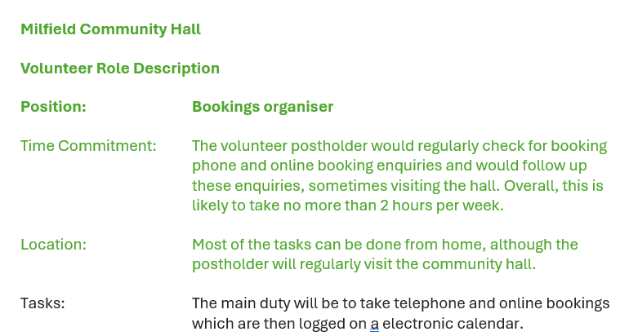
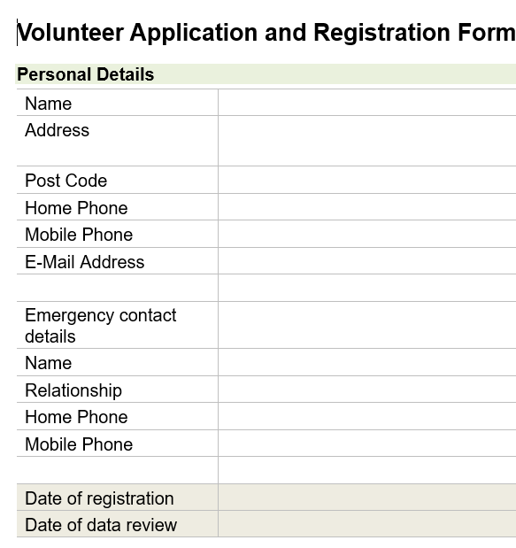
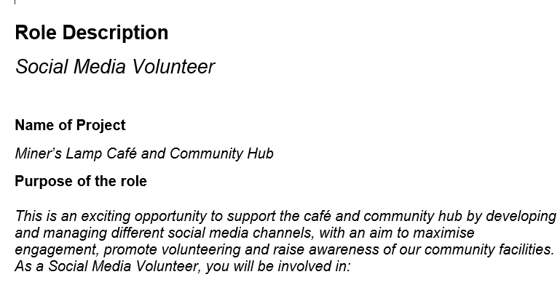
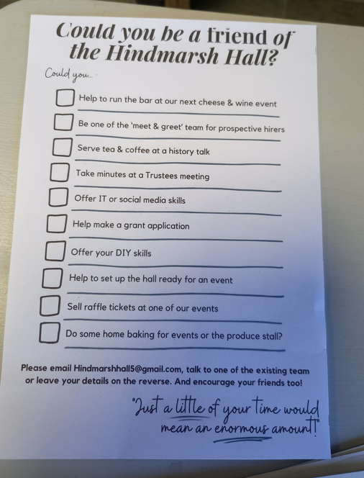
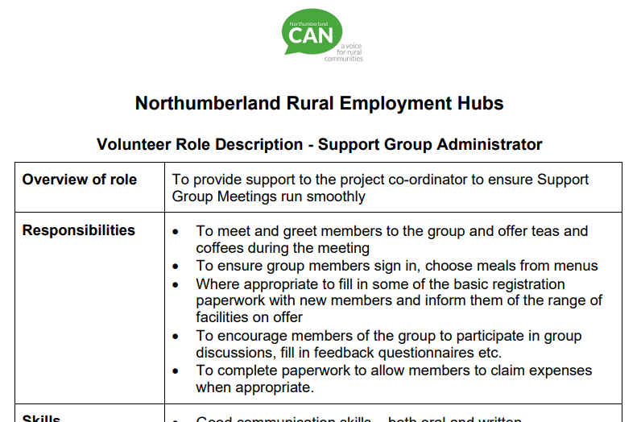


New volunteering opportunites
Notes:
We have been able to help voluntary groups to more clearly define volunteer roles, helping with promotion, recruitment and support. We have had several successes, not least within CAN itself, where we now support more volunteers than before.

Slide 4



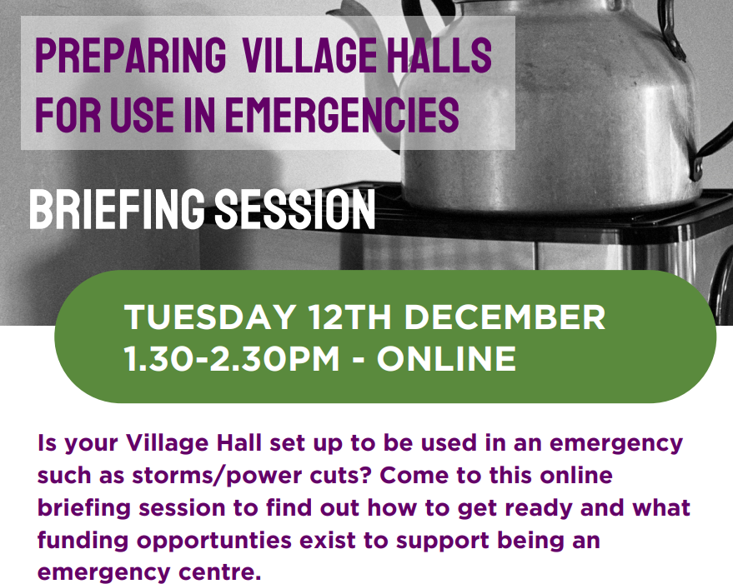



Training and awareness sessions
Notes:
A wide range of training and awareness sessions for volunteers – including the volunteers who manage village halls – has been an important part of our work. Its fair to say that we have helped equip volunteers with the skills and knowledge to give them greater resilience and strength to achieve more.

Slide 5
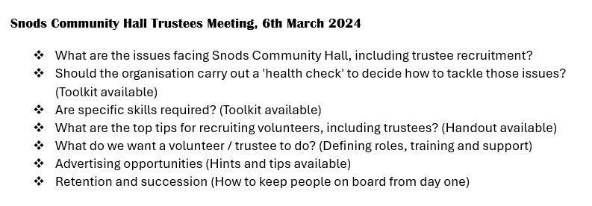

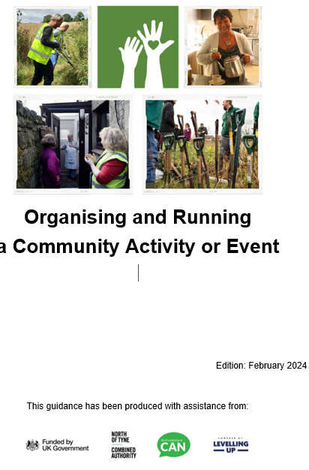

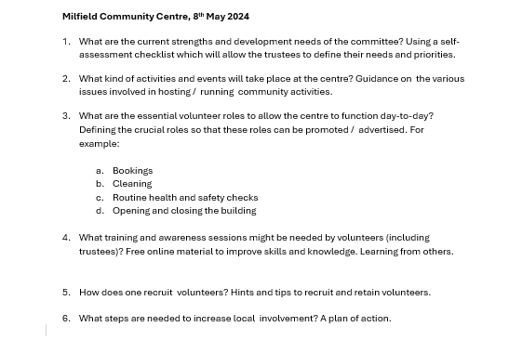

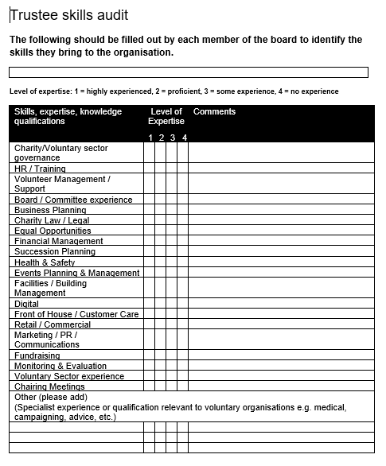
Supporting volunteer groups in rural areas
Notes:
The volunteering development project has given us an opportunity to work closely with community groups, looking at their volunteer-related needs. We have been able to provide a wealth of information, advice and guidance to help. We have promoted good practice. But perhaps more importantly we have simple given groups added encouragement and a few new ideas.

Slide 6
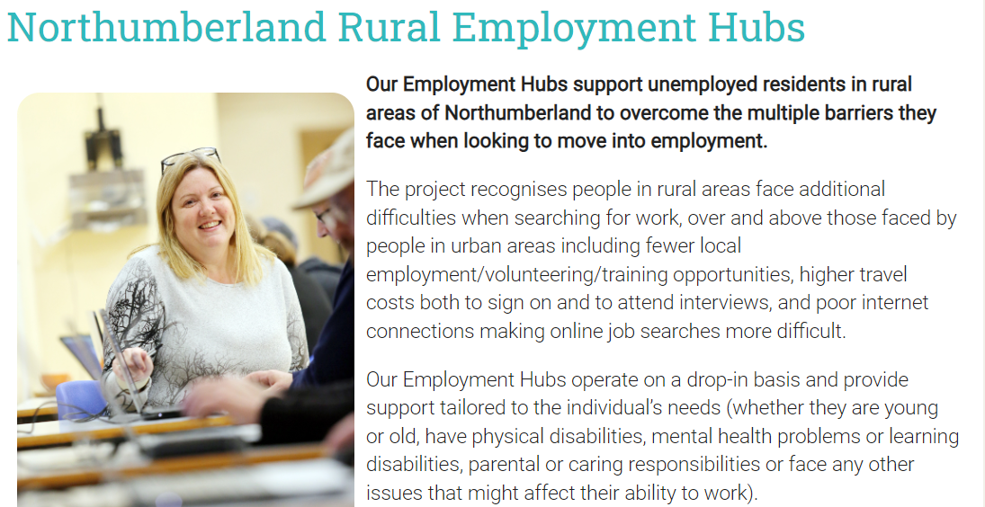

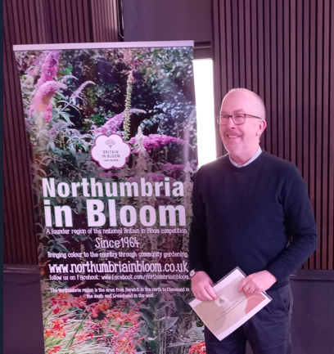
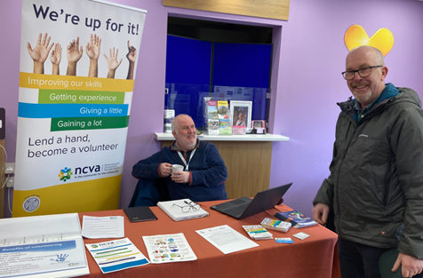
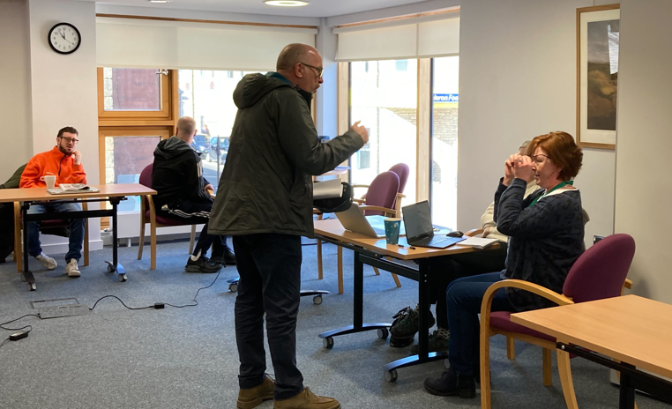

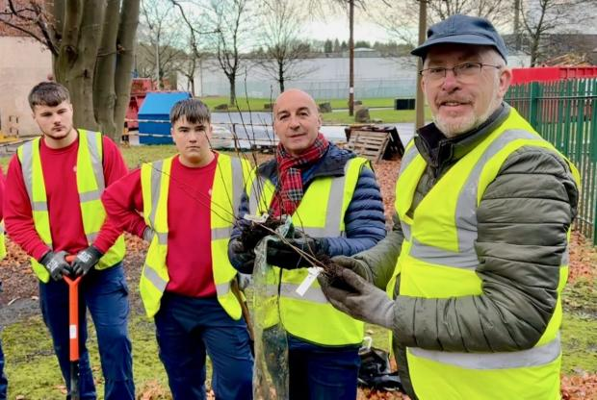
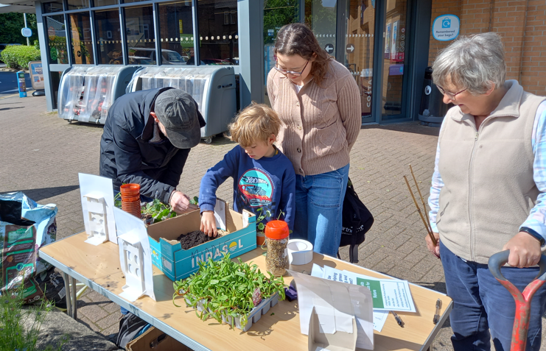
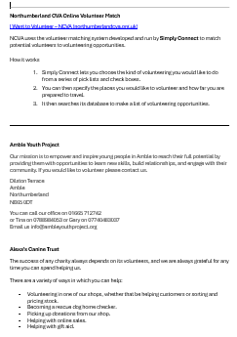
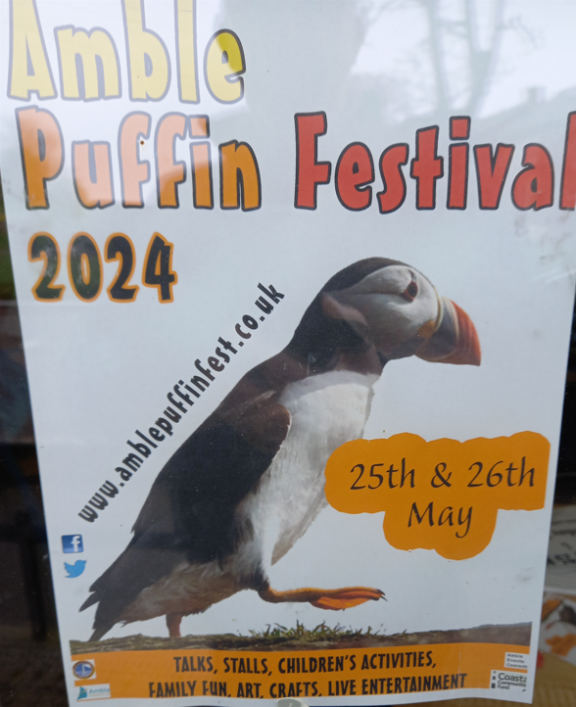
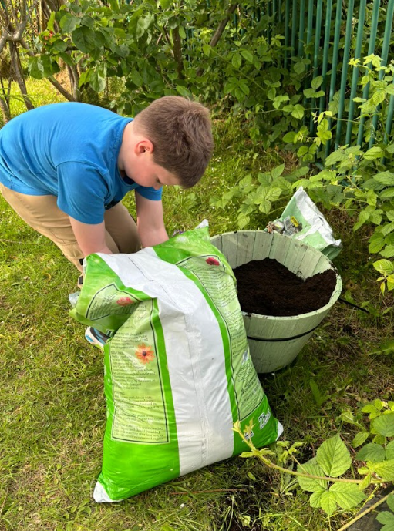
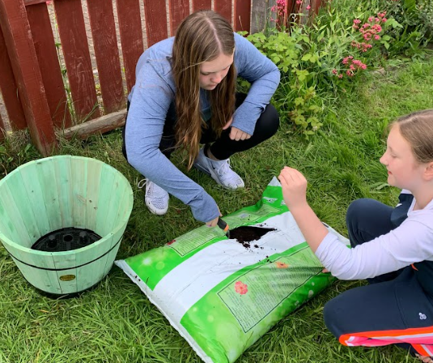

Social action, events & activities
Notes:
Promoting and attending local events and activities is always important. As the illustrations show we have actively promoted volunteering to clients visiting employment hubs, we have attended volunteer fairs, spoken to large audiences about ways to recruit volunteers and have encouraged community groups to use their social action events as a means of recruiting volunteers.

Slide 7
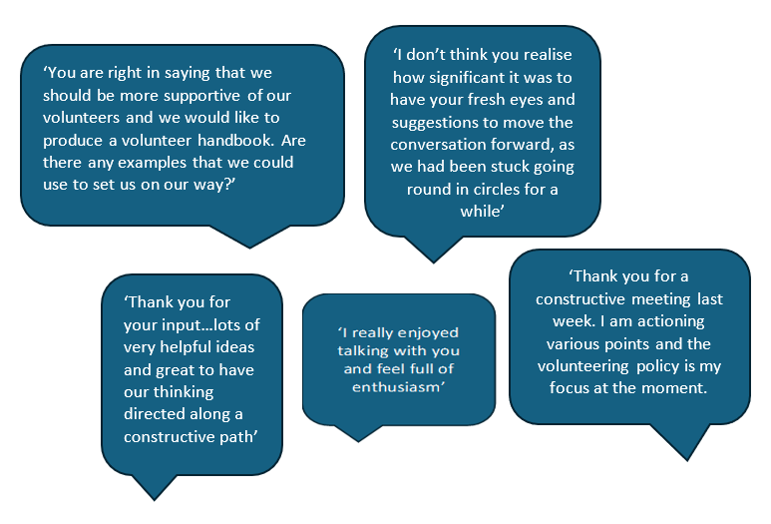
Encouragement and ideas
Notes:
I think that the volunteering project is proving beneficial, and we have received several positive comments and these examples I think illustrate the project’s impact.

Slide 8

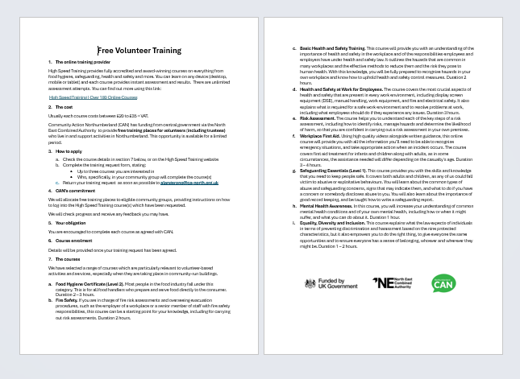
Online training for volunteers
Notes:
To date 81 training places have been booked for xx people in xx community organisations. The most popular course has been the Food Hygiene Certificate (Level 2).
If you haven’t taken advantage of this offer yet, there is just time – see me at the tea break!

Slide 9
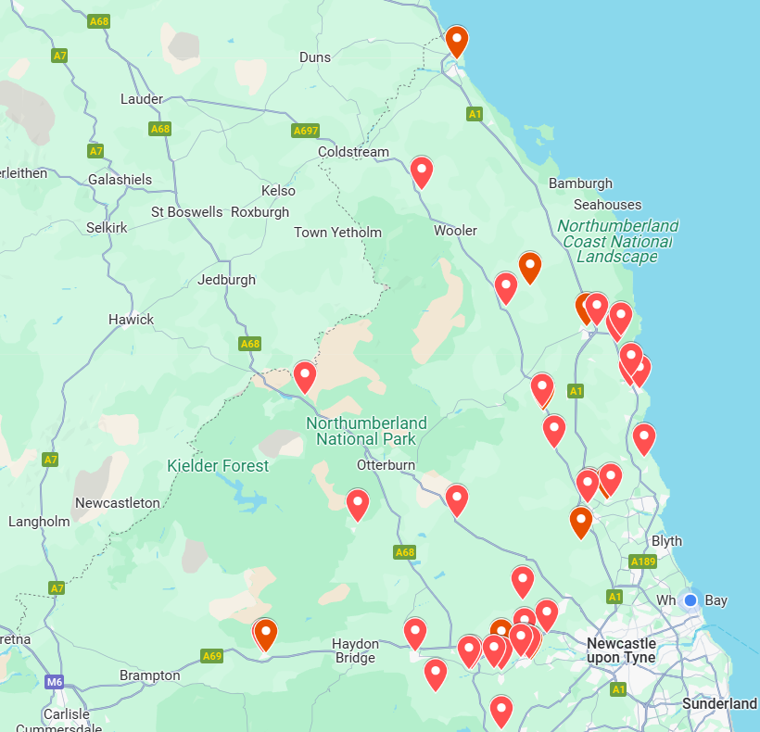
Volunteering development support

Slide 10
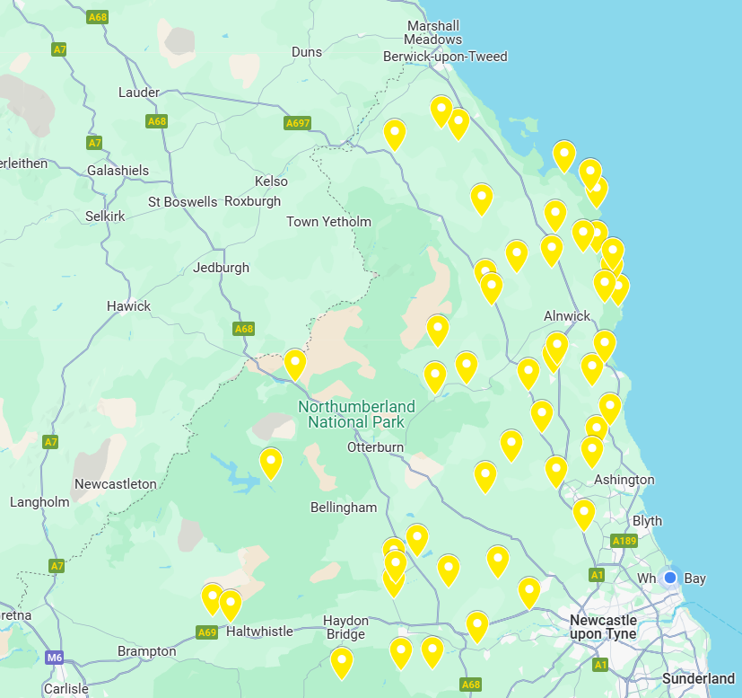
Training and development specifically for village hall volunteers

Slide 11
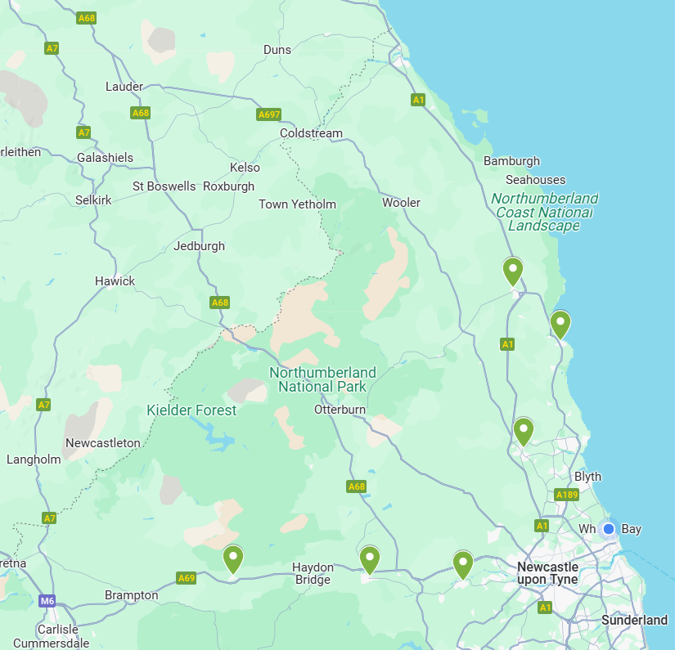
Encouraging volunteering at Rural Employment Hubs

Slide 12
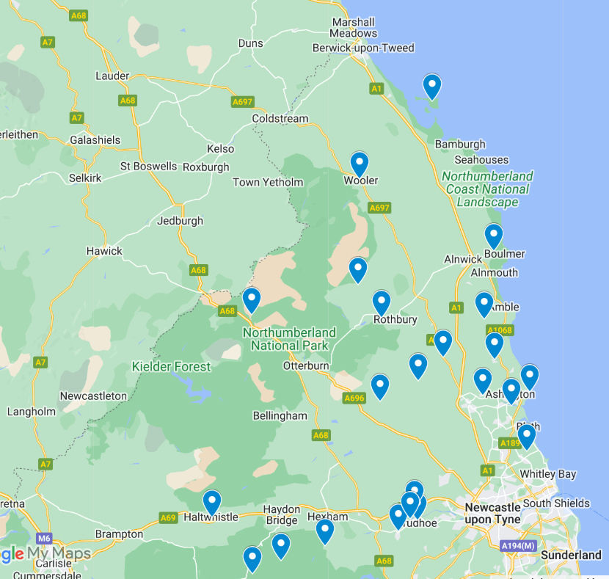
Volunteer groups receiving free online training courses

Slide 13

Volunteering support
- The overall picture

Slide 14
Volunteering support
The overall picture
Thank you!

