Slide 1


Energy and
Renewables Advice Online Roadshow

Slide 2

Energy and Renewables Advice Online Roadshow
Introduction and Welcome from Andrew, Brian, Jake and Anna
Fabric First Approach & Retrofit
Renewables & Heat Sources
Air Source Heat Pumps (ASHP)
Solar PV & Batteries
EV and Tariffs
Pros & Cons of Renewables
Overview of Support & Grants
Q&A

Slide 3

How is the climate changing?
Record temperatures across the world, this year the hottest ever
Unusual and extreme weather events
More prolonged natural events such as wildfires, typhoons and flooding
Disappearance of ice across the world leading to rising sea levels
Areas of tundra melting releasing huge amounts of methane

Slide 4
The importance of considering the Fabric First approach with Retrofit
The Fabric First approach to net-zero retrofitting involves improving a building's energy performance primarily through modifications to its physical fabric, rather than solely relying on advanced technologies and renewable energy systems.
This approach emphasises minimising energy demand by enhancing the building envelope and employing passive design strategies to reduce the amount of energy a building uses.

Slide 5
What is Retrofit?
Retrofit refers to any improvement work on an existing building to improve its energy efficiency, making them :
  easier to heat
  able to retain that heat for longer
  replacing fossil fuels with renewable energy
In the UK we are facing two big problems:
  Rising energy prices and
  The urgent need to reduce carbon emissions if we’re to reach net-zero by 2050

Slide 6
Benefits of Retrofit
Retrofitting our homes and buildings is one of the biggest challenges the UK faces in our efforts to reach net zero
Many homes aren’t fit for purpose, in fact the UK has some of the oldest and worst housing stock in Europe in terms of energy efficiency. UK homes accounted for 17% of all carbon emissions in 2022
Heat is constantly leaking out through windows, doors, and uninsulated walls, making our heating systems work harder costing more money and providing less warmth
We’re paying for wasted energy

Slide 7
Examples of Retrofit
Prioritising energy efficiency measures
Insulation :
  Loft Insulation
  Wall insulation: Cavity, Internal and External wall insulation
  Floor insulation
Draught-proofing and ventilation
Consider replacing windows and doors
Usually, you complete retrofit measures before considering larger measures like solar panels and heat pumps

Slide 8
Renewables & Heat Sources

Slide 9
Renewables
Air Source and Ground Source Heat Pumps (ASHP and GSHP)
Biomass
Wind
Solar Photovoltaic panels (PV) & Solar Thermal
Hydro Power
Alternative Fuels
  Hydrogen , Bio Gas and Hydrogenated Vegetable Oil (HVO)

Slide 10
Air source heat pumps (ASHP's)
ASHP's work like a fridge in reverse and are very efficient, measured by their coefficient of performance (CoP). Most will produce 3 to 4 kwh's of energy for each kwh used
Need external space and an internal hot water tank (around 200 litres so the tank is large)
Pumps produce lower temperature water than gas or oil boilers do, so often have to upgrade pipework and/or radiators to increase water flow
Cost can be up to £15000 but boiler upgrade grant of £7500 will reduce this
ASHP's work best in well insulated homes and with underfloor heating
Like all renewable technologies, the pumps are reducing in price and becoming more efficient

Slide 11
Solar photovoltaic panels (PV)
Convert daylight/sunlight into direct current (which is converted to usable AC by an inverter)
Most panels are polysilicon but peroskovite is being developed as an option
Efficiency varies but not enough to worry about
Can be roof mounted (on a frame or free standing on flat roof) or ground mounted
Panels are normally 1.7m x 1m and modern panels produce around 430/440 watts of power each so 10 panels would give 4.4kw, average domestic installation (more panels may incur grid connection cost)
When fitting panels should avoid shading, south facing is best but only north facing panels do not work well

Slide 12
Solar photovoltaic panels (PV)
Each 440w panel will produce around 750 kilowatt hours in a year but mostly in the spring summer and autumn
Average household uses around 25000 kwh of electricity equivalent for heating and hot water Annual use/production profile is as below
Quarter |  | Panels produce (%) | Dwelling consumes (%)
Jan to March |  | 13 | 39
Apr to Jun |  | 44 | 14
Jul to Sept |  | 35 | 11
Oct to Dec |  | 8 | 36

Slide 13
Solar photovoltaic panels
Quarter | Consume | Produce | Shortfall | Cost of electrical heating (£s) | Cost of oil heating (£s) | Cost of mains gas heating (£s) | Cost of ASHP heating (£s)
Jan to Mar | 9750 | 488 | 9263 | 926 | 602 | 741 | 324
Apr to Jun | 3500 | 1650 | 1850 | 185 | 120 | 148 | 65
Jul to Sept | 2750 | 1313 | 1438 | 144 | 93 | 115 | 50
Oct to Dec | 9000 | 300 | 8700 | 870 | 566 | 696 | 305
Annual figures | 25000 | 3750 | 21250 | 2125 | 1381 | 1700 | 744

Slide 14
Solar photovoltaic panels
Figures relating to previous slide
Annual consumption of 25000 kwh electricity equivalent
A battery is fitted to store excess power from pv panels and charged using off peak power from the grid at 10p per kwh
Oil costs 6.5p per kwh
Gas costs 8p per kwh
ASHP costs 3.5p per kwh (Pump has CoP of 3)
Capital outlay of £16000 for solar panels, battery and air source heat pump (including grant funding of £7500 towards cost of fitting pump)

Slide 15
Solar photovoltaic panels (PV)
The previous figures show that panels cannot replace all energy use by themselves because of the consumption/production profiles even when trying to maximise power use when the sun is shining
Use of a battery and an air source heat pump can transform this position however
Check out solar wizard for a rough idea if a home is suitable for solar plus installation costs, production capacity etc. Rule of thumb, a 10 panel, 4.4kw system will cost between £6000 and £7000

Slide 16
Domestic batteries
Use to store unused power from your solar panels
Or you can store cheap off-peak power for use later
Becoming cheaper and more efficient almost day by day
Drawbacks are mainly that they are relatively expensive (Tesla batteries can be up to £10000 each) and so have long payback periods
If you have an electric vehicle you can store power from solar pv and the grid for use in your home if your vehicle is v2g (vehicle to grid enabled) so no need for domestic battery
You can fit multiple batteries and the most modern ones are small

Slide 17
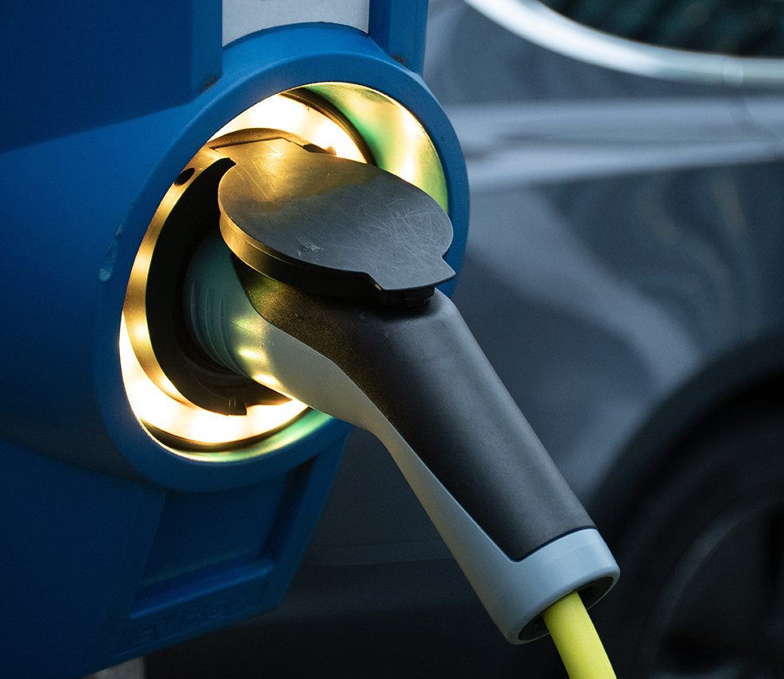
Electric Vehicle Tariffs
What are they?
A smart meter is required
Dual fuel tariffs are available, but not always great deals
EV tariffs can be like Economy 7 tariffs
Are they cheaper than a normal tariff?

Slide 18

EV Tariff Requirements
How do I compare tariffs?
Some tariffs require specific cars
Some tariffs require specific smart chargers
Does the Ofgem price cap apply?

Slide 19
Pros & Cons of Renewables
Things to consider….
Expensive to install
Eligibility to grants is limited
Disruption to householders
Works differently (ASHP is on 24 hours a day)
The sun does not always shine …
Electricity is expensive
Housing stock is not fit for purpose
Without grants Retrofit is very expensive, often prohibitively

Slide 20
Pros & Cons of Renewables
Benefits of ….
Very efficient
ASHP have a COP of 3 to 4 (Co-efficient of performance)
Reduces impact of carbon on the environment
Add value to your property
Fossil fuels will be phased out eventually
Renewables use electricity more efficiently
Other renewables
  Biomass, Wind, Solar Thermal, Hydroelectric and GSHP

Slide 21
Overview of Support and Grants
ECO4 (Energy Company Obligation scheme)
ECO4 Flex e.g. existing health conditions vulnerable to the cold
HUG (Home Upgrade Grant) – administered by Northumberland County Council and a new scheme is planned
BUS (Boiler Upgrade Scheme)
GBIS (Great British Insulation Scheme)
New initiatives are expected as part of the drive towards Net Zero 2050

Slide 22
Q&A
Any Questions?

Slide 23
Resources, newsletters, websites to follow:
Energy and Climate Information Unit - eciu.net pv magazine - pv-magazine.com
North East and Yorkshire Net Zero Hub – neynetzerohub.com
Centre for Sustainable Energy (CSE) - cse.org.uk
National Energy Action (NEA) - nea.org.uk
Ofgem - ofgem.gov.uk
Energy Savings Trust (EST) – energysavingtrust.org.uk

Slide 24

Thank you for attending
If you have any further queries we are available
Contact CAN energy team at renewables@ca-north.org.uk or
Telephone 01670 517 178

