Slide 1



Welcome to Northumberland
Village Halls Week
Celebration Event!

Slide 2

Jean Humphrys
Chair of CAN
Welcome and
introduction
to the event

Slide 3
Robin Fry
Inclusive Economy Advisor,
North East Combined Authority
Benefits of Volunteering from an individual and NECA perspective

Slide 4
Alan Gerono
Volunteering Development Officer
CAN
Volunteering Development Project Summary

Slide 5
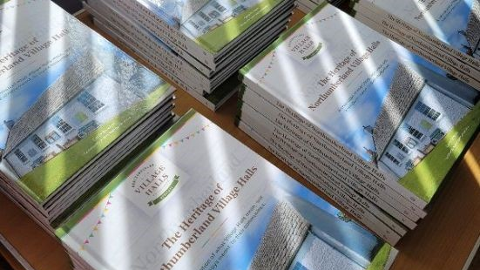
Book Raffle
Refreshments break
and time for networking

Slide 6
Marc Johnson
Digital Inclusion Lead, CAN
Digital Inclusion Project

Slide 7
Volunteering in my community: top tips
Trustee representatives
Judith Stonebridge - Crookham Village Hall (film)
Maureen Bickerdike - Hindmarsh Hall, Alnmouth
Austin Iliffe - West Northumberland Community Buildings Consortium

Slide 8
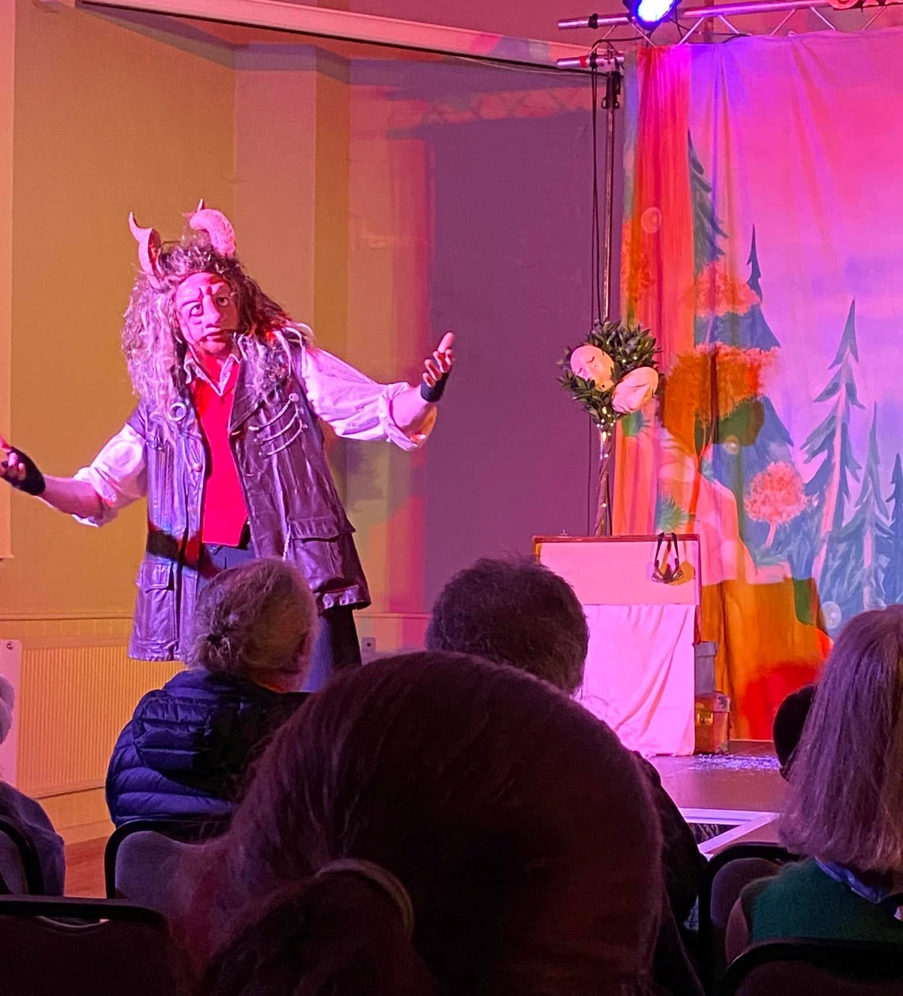
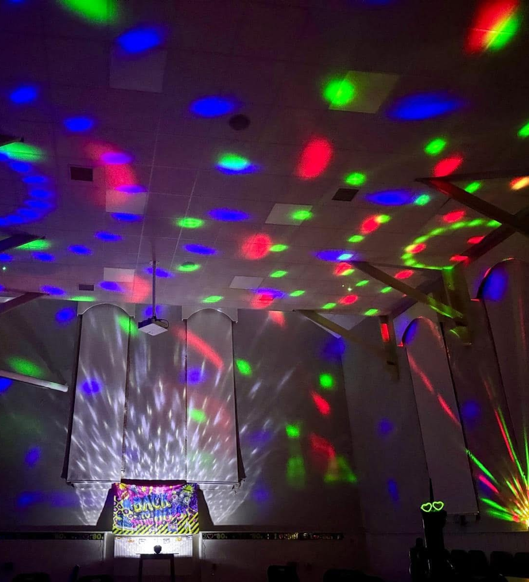
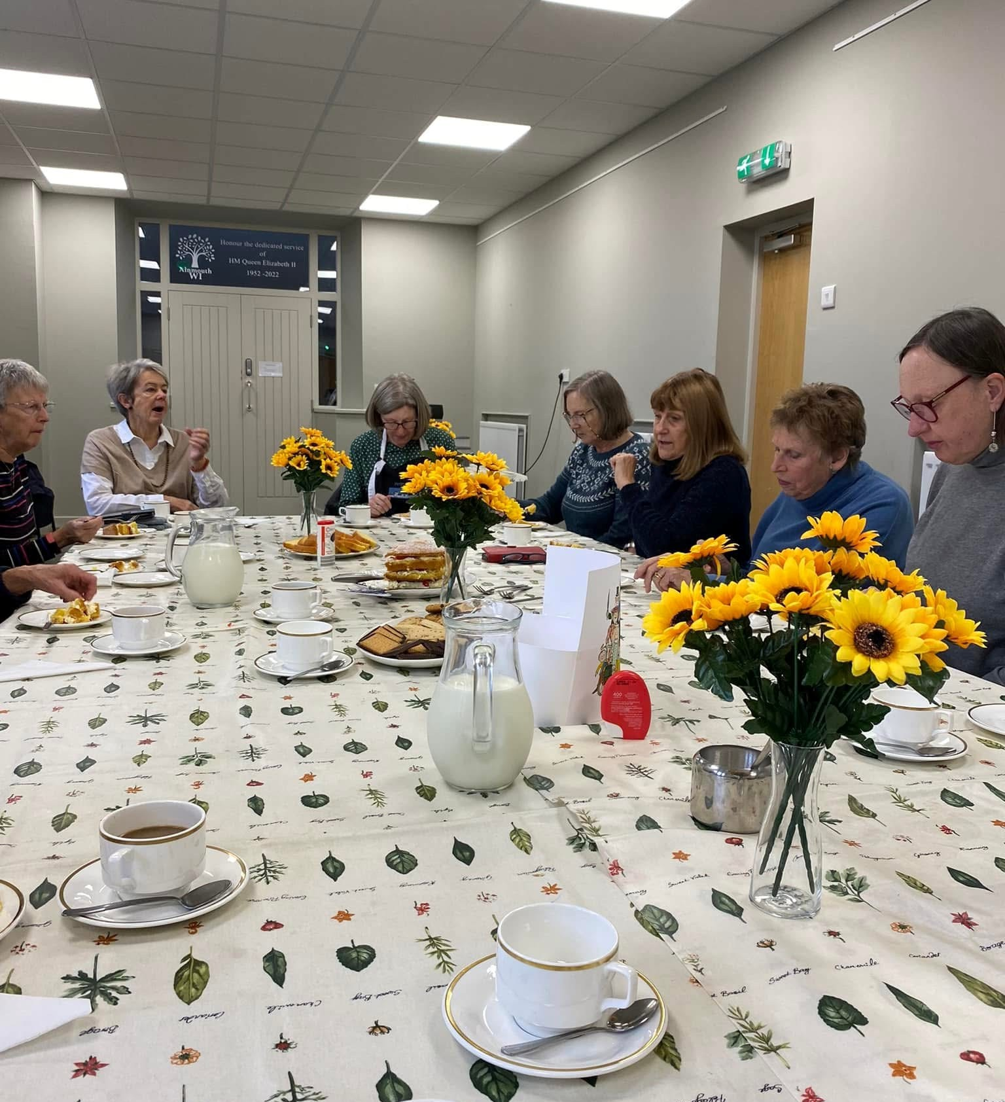
Maureen Bickerdike –
Hindmarsh Hall, Alnmouth

Slide 9
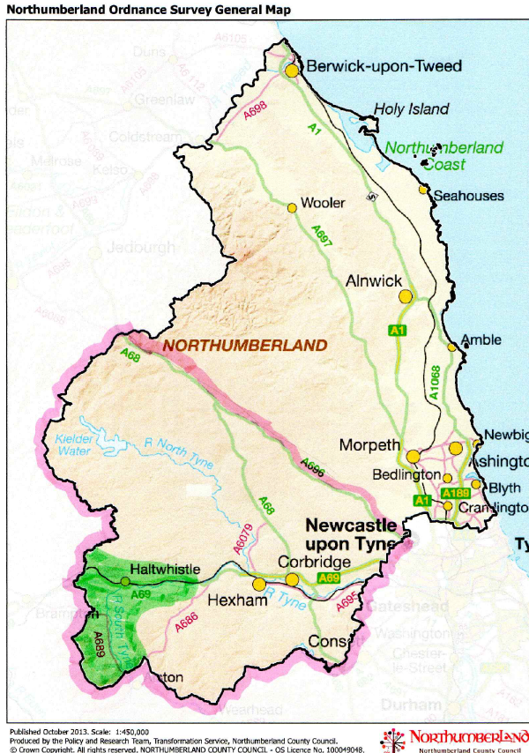
Austin Iliffe
PAT Testing
West Northumberland Community Buildings Consortium

Slide 10

YouTube
Celebratory poem recording read by village hall volunteers from across the country.
Produced by ACRE

Slide 11
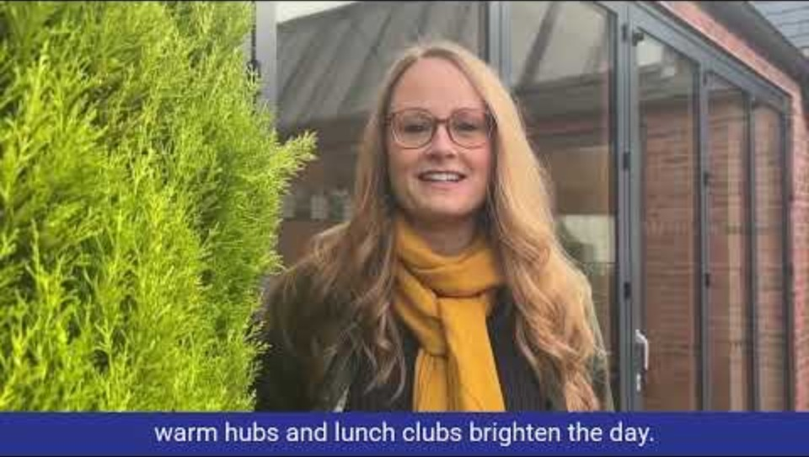

Slide 12
Lunchtime
Break

